Slide 1
FlexPod: Platform for Innovation for Partners
Jan 2020

Slide 2

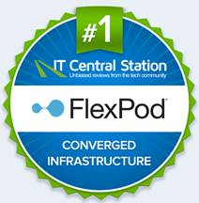

FlexPod Momentum
Success by the numbers
$13.5B+
9,500
170+
combined revenue to date
FlexPod customers
around the world
validated designs
6,000+
1,100
250
petabytes sold
partners serving 100 countries
person-years of joint engineering
10-Years of evolving technologies, innovations and solutions:
New foundational FlexPod technology updates
Modern workloads: AI/ML, latest enterprise applications
The most cloud-connected CI platform
FlexPod Recognitions and Accolades
World’s most trusted CI platform**
FlexPod storage continues to garner awards
FlexPod has 30% share from Q42018 to Q42019*
*IDC Converged Systems Tracker, WW Integrated Systems and Reference Architectures. Q4 2018 – Q3 2019
** Top Rated ITCS Converged Infrastructure Solutions 2018 , 2019
Notes:
FlexPod has a leadership position in the industry in the converged stack, thanks to our decade long partnership with NetApp. Our success is based on our shared technology vision—we share a common culture—share a common approach on how we take our products and solutions to the market. Our converged stack has more than 9,500 customers worldwide. Offered by more than 1,100 partners worldwide and present in more than 100 countries
We’ve sold over 6,000 petabytes of storage and jointly generated over $13.5B dollars in revenue. Our success is powered by joint innovation and integration—we have delivered over 170 validated designs that simplify deployment and operation for our customers and partners.
FlexPod is a proven market leader with an investment of over 250 person-years of engineering. Through these strong investments and customer relationships, we make innovation easier to deploy in enterprise data centers. Simplifying the delivery and deployment of FlexPod gives partners an advantage in delivering new services and applications.
FlexPod was recognized by CRN, with FlexPod being named as the winner of the 2019 Product of the year nomination.
NetApp Storage Arrays A320 and A800 both won 2019 CRN Products of the Year:
https://www.crn.com/slide-shows/mobility/crn-s-2019-products-of-the-year/1
What are users saying about FlexPod? FlexPod is the number-one converged infrastructure solution on IT Central Station, a peer-review site for IT professionals, two years in a row.
https://www.itcentralstation.com/products/flexpod-use-of-solution

Slide 3
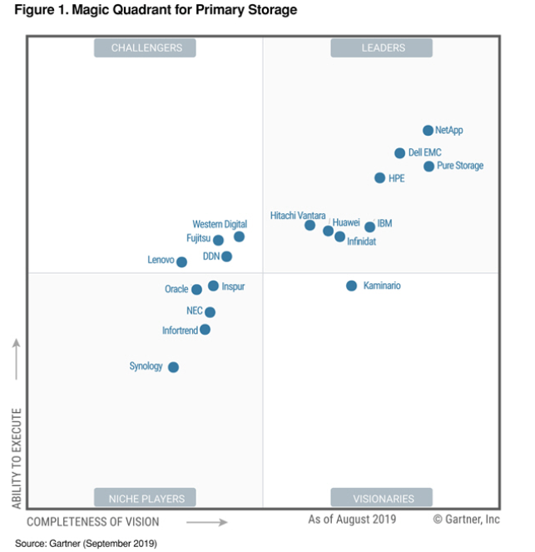
A Leader in Primary Storage
NetApp recognized as a Leader in 2019 Gartner Magic Quadrant for Primary Storage
This Magic Quadrant was published as part of a larger research note and should be evaluated in the context of the entire report. The full report is available from NetApp here.
This graphic was published by Gartner, Inc. as part of a larger research document and should be evaluated in the context of the entire document. The Gartner document is available upon request from NetApp. Gartner does not endorse any vendor, product or service depicted in its research publications, and does not advise technology users to select only those vendors with the highest ratings or other designation. Gartner research publications consist of the opinions of Gartner's research organization and should not be construed as statements of fact. Gartner disclaims all warranties, expressed or implied, with respect to this research, including any warranties of merchantability or fitness for a particular purpose.
Source: Gartner, Inc., 17 September 2019
Santhosh Rao, John Monroe, Roger W. Cox, Joseph Unsworth
GARTNER is a registered trademark and service mark of Gartner, Inc. and/or its affiliates in the U.S. and internationally, and is used herein with permission. All rights reserved.
Notes:
Do not alter this slide or the graphic. The slide must be used as it. Any changes will require Gartner’s further review.
Gartner, Inc., 17 September 2019
Santhosh Rao, John Monroe, Roger W. Cox, Joseph Unsworth

Slide 4
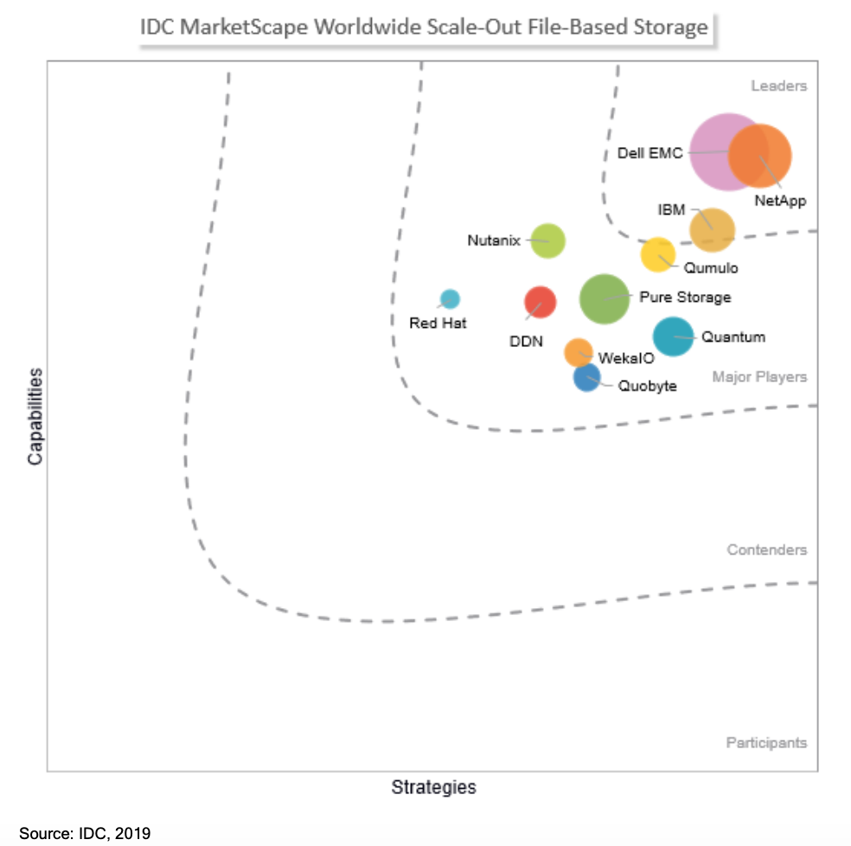
NetApp Named a Leader in IDC MarketScape:
Worldwide Scale-out File-Based Storage 2019 Vendor Assessment
IDC MarketScape report excerpt:
NetApp Strengths
NetApp's FBS offering is a very well-established offering in the market with worldwide adoption across several workloads and use cases. NetApp has an extensive and loyal customer base that is well skilled in the use of ONTAP and may lead to adoption of ONTAP in the public cloud.
Consider NetApp When
Customers in need of an FBS on-premises and hybrid cloud strategy should consider NetApp because of its expanded product portfolio, investment, and vision.
The report is available from NetApp here.
IDC MarketScape: Worldwide Scale-out File-Based Storage 2019 Vendor Assessment, Doc # US45355019, December 2019
IDC MarketScape vendor analysis model is designed to provide an overview of the competitive fitness of ICT suppliers in a given market. The research methodology utilizes a rigorous scoring methodology based on both qualitative and quantitative criteria that results in a single graphical illustration of each vendor’s position within a given market. The Capabilities score measures vendor product, go-to-market and business execution in the shortterm. The Strategy score measures alignment of vendor strategies with customer requirements in a 3-5-year timeframe. Vendor market share is represented by the size of the circles. Vendor year-over-year growth rate relative to the given market is indicated by a plus, neutral or minus next to the vendor name.
© 2020 NetApp, Inc. All rights reserved.
Notes:
Source: IDC MarketScape: Worldwide Scale-out File-Based Storage 2019 Vendor Assessment, Doc # US45355019, December 2019
Note - This slide may not be modified nor may the data be reused in any other format without permission from the analyst firm.

Slide 5





Digital Transformation
Driving New Apps and Consumption Models
Multicloud
Core
Edge
Modern applications
Modern workflows
Proven, trusted solutions
Seamlessly adopt
new applications
Easily connect
and optimize
Validated solutions
by industry leaders
Notes:
Digital transformation is driving new applications and consumption models that are shaping enterprise IT infrastructure strategies. IT needs to deliver applications, both new and traditional, faster than ever before. The business will not wait, and users demand a proven, simplified experience. The public cloud is now a requirement, and the capability for on-premises resources to be connected with a portfolio of clouds (public, SaaS, etc.) to optimize cost, performance, SLAs, etc., is crucial for success. In this multicloud world, IT teams need to be able to easily deploy and manage applications in multiple data center, private cloud, and public cloud environments. These trends are driving the need for new platforms and solutions with secure connectivity, accelerated computing, multicloud orchestration, and operational analytics capabilities. FlexPod integrates the latest innovations from Cisco and NetApp, helping IT unleash the potential of your data and accelerate the delivery of modern applications with a trusted platform for innovation that is tailored to meet the needs of your business and unmatched versatility to support your multicloud strategy.

Slide 6
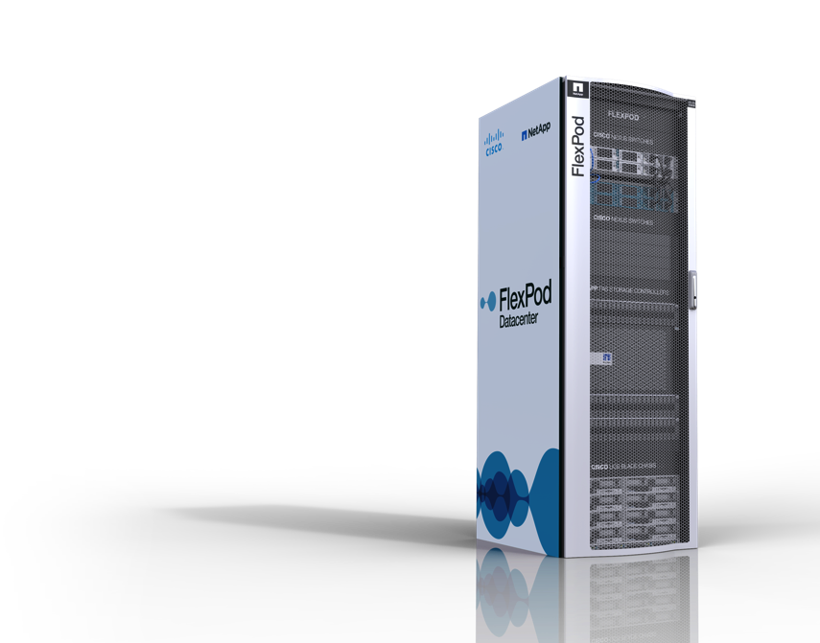
Confidently Power Modern Workloads
Power modern AI and enterprise applications with the latest platform innovations
Embrace the cloud with confidence
for unmatched versatility
Deliver a better customer experience
with a platform trusted worldwide
Notes:
FlexPod is the platform that will enable you to unleash the potential of your data—a platform for innovation that provides unmatched versatility and is trusted worldwide.
FlexPod fuels your adoption of innovative technologies with a core platform for your cloud strategy. With FlexPod you can easily implement cloud solutions to extend your infrastructure while taking advantage of next-generation technologies like ML and AI.
FlexPod also provides unmatched versatility in the marketplace, as multiple, flexible configurations and models ensure that your FlexPod is tailored to meet the unique needs of your business.
Finally, FlexPod is a field-proven platform that is trusted worldwide—as evidenced by its continued growth and momentum in the marketplace.
Let’s drill into what FlexPod can offer your business.
<click>

Slide 7


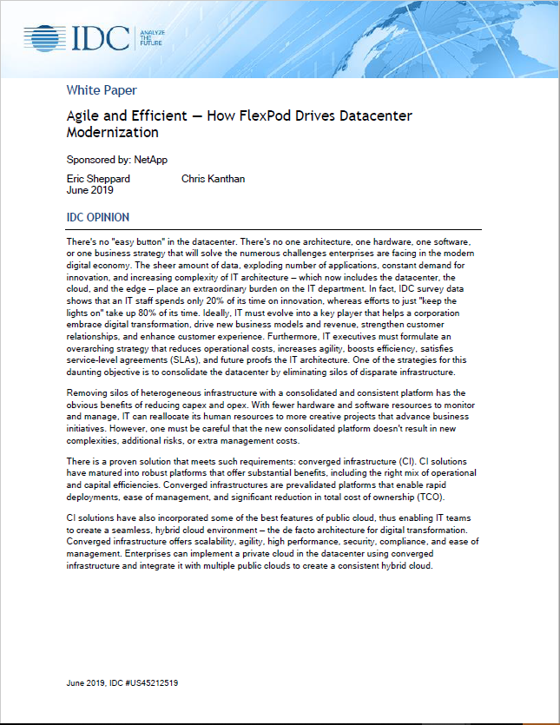


Why Customers Choose
FlexPod
“Agile and Efficient – How FlexPod
Drives Datacenter Modernization”
Download the white paper
Efficiency
29% – 33%
Efficiency gain after deploying FlexPod
Risk Mitigation
41% – 60%
Reduction in downtime
Savings
24% – 34%
Reduction in Opex
and Capex
Performance
41% – 62%
Reported performance gains in multiple areas
Source: IDC Customer Survey published in 2019
Source: IDC Customer Survey published in 2019

Slide 8
The History of Innovation Continues
FlexPod with infrastructure automation
end-to-end NVMe
Unified
financing
Secure enclave
architecture
All
Flash
100
GbE
FlexPod
w/SAP
OpenStack
Docker
Storage
Cld
Tiering
FlexPod
launched
FlexPod
Clustered
Data ONTAP®
3-year
strategic
agreement
FlexPod
w/Oracle
Metro
cluster
Factory integration
Hybrid
cloud
LCM
40G
fabric
Infrastructure
Application
Enterprise / Verticals
Cloud
EHR
AI
2011
2012
2013
2014
2015
2016
2017
2018
2019
2020
Secure
multi-
tenancy
FlexPod
w/Citrix
FlexPod
Select
Citrix in cooperative support
Microsoft in cooperative support
UCS mini
AltaVault
PaaS
AI/ML
FlexPod for Edge / RoBo
FlexPod
w/Microsoft
FlexPod
Express
UCS Director
Cisco
VMDC
Cisco ACI
FSA One
HEC
MPC
Healthcare
EPIC EHR
Healthcare
Notes:
170+ validated designs. 9,000+ FlexPod customers.
Cisco and NetApp help manage FlexPod, protecting your customer’s investment throughout the entire lifecycle. Cisco and NetApp recreate customer environments in their labs for maximum support.
15+ years of partnership. Joint success: over $10B in revenue generated.
250+ person-years of joint engineering have gone into FlexPod® since its inception.

Slide 9
What is FlexPod

Slide 10
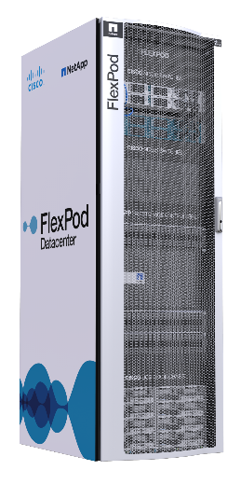
FlexPod Converged Infrastructure
Prevalidated flexible, unified platform
Cisco Unified Computing System™
  Programmable infrastructure
  Unified management
Cisco Nexus® switches
  Unified fabric
NetApp ONTAP® Storage Systems
Unified storage
Intelligent data management
Notes:
FlexPod is the converged infrastructure solution from NetApp and Cisco.
FlexPod accelerates the transformation from infrastructure silos to a virtualized, shared environment with prevalidated, standardized, scalable building blocks that leverage a next-generation data center solution from Cisco, NetApp, and leading OS and hypervisor partners.
The solution is prevalidated integrated, so customers can count on an effective infrastructure, with rapid, repeatable deployment, and centralized and simplified management.
FlexPod includes Cisco Unified Computing System (Cisco UCS) server systems, which provide programmable, virtualized compute with an open API and support for orchestration tools. It has its own policy-based management with service profiles and self-integrating components. And works with the Cisco Nexus series switches for a unified fabric, virtualization awareness, simple scaling and high performance I/O.
FlexPod also features NetApp FAS storage, along with clustered Data ONTAP. FlexPod stands apart from similar solutions thanks to truly unified storage that can be virtualize into pools and nondisruptively managed. FlexPod also uses OnCommand storage software that delivers the built-in storage efficiencies of Data ONTAP, integrated data protection and intelligent management and automation.

Slide 11

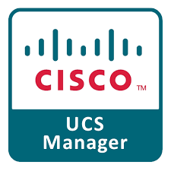
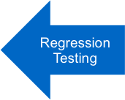
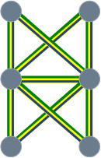
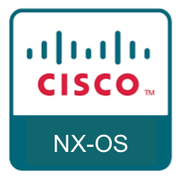

FlexPod is the Fabric
Any UCS Server
Fabric architecture is the one fixed FlexPod element
E2E Protocol Inter-operability Testing
Any Nexus Switch
Any AFF/ FAS Controller

Slide 12
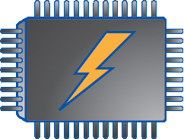



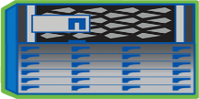

Software Defined Architecture
Secure Enclave Architecture
Pool resources
Single server pool/storage pool
Service profiles for consistent policy-based Server deployments
Abstract resources
Virtualized servers and storage
Stateless computing
Dynamic scalability; app, data mobility
Consume resources
Service catalogs
Rapid resource provisioning in
accordance with SLAs
Open APIs for self-service/user-driven resource consumption
App
App
App
App
App
App
Bare Metal
Virtualization
Virtualized Compute Pool
10,000s
Cores
Virtualized Network Pool
1000s of VLANS
Virtualized Storage Pool
100’s of PB

Slide 13

Easier to Operate
Service Catalog
- or -
OpenStack, Ansible, Puppet, Chef
UCS Director
Programmable infrastructure
Validated unified management
Customized workflows
App
App
App
App
App
App
Bare Metal
Virtualization
Virtualized Compute Pool
APIs
APIs
Virtualized Network Pool
Virtualized Storage Pool
APIs

Slide 14
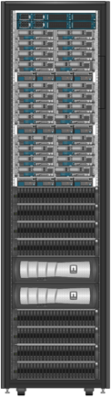
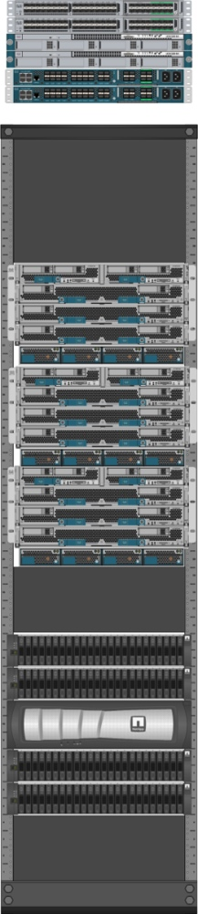
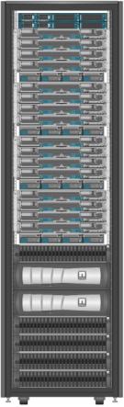
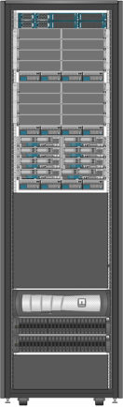
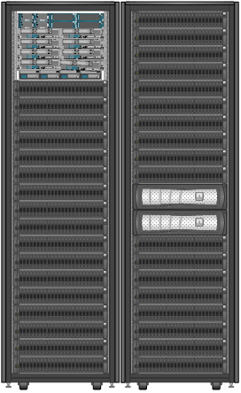
Flexibility to Adapt to Workloads
Production Balanced Infrastructure
VDI
CPU
Develop and Test
Memory
Capacity
IOPS
Higher Performance
Blades, Flash, and More IOPS
More Computing and
Less Storage
Starting Out
Data Protection and Backup
Deploy Entry System;
Then Scale Up
Less Computing and
More Storage

Slide 15
FlexPod helps IT accelerate business
Service Request
Service Available
Traditional
Many Weeks or Months
Design and
Size
DC
Planning
Procure
Detailed
Design
Deploy
Test
X
X
With FlexPod®
Reference BOM
Validated design
Precise deployment
Standard test plan
> 50% Faster
DC
Planning
Procure
Deploy
Test
Service Available
Preprovisioned FlexPod
Rapid deployment of applications
Shared pools meet most requirements
DC
Planning
Procure
Deploy
Test
Service Available
Notes:
Many organizations perform the following steps when servicing a new application or requirement:
Collect detailed requirements.
Architect and size: Work with the vendors to architect and size the system. Depending on the number of applications and the number of vendors involved, the sizing and architecting phase can take many weeks and often months.
DC planning: Work with the data center team to negotiate power, floor space, and cooling requirements for the new system.
Procure equipment: This phase involves many weeks of obtaining quotes, ordering, and receiving the new gear. The time it takes to deal with a large organization, plus additional shipping times, can easily total six weeks.
Detailed design: This phase involves working out the exact configuration for compute configuration, network connectivity, storage layout, security, and isolation.
Deploy: Configure the equipment for use.
Test: Create and run a test plan to make sure that the equipment is correctly installed and meets the original requirements.
By using FlexPod, many of these phases are compressed or removed altogether. Customers who take the standardized approach to IT have repeatedly demonstrated better than 50% faster deployment times over traditional approaches. Cisco, NetApp, and VMware provide the reference collateral (sizing, design, deployment, and testing) to standardize this deployment approach for all customers.
Many organizations don’t know the future demands that will be placed on IT, but IT is expected to be very responsive. So going a step further by forward (preprovisioned) FlexPod as a pool of infrastructure, the compute, network, and storage resources are on the floor already, and it is a very rapid process to meet business needs.
You can efficiently preprovision infrastructure only if it augments pools of shared infrastructure and satisfies a wide range of application requirements. FlexPod for VMware has been architected to meet a wide range of application demands from shared infrastructure pools that are centrally managed.

Slide 16



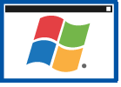

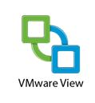






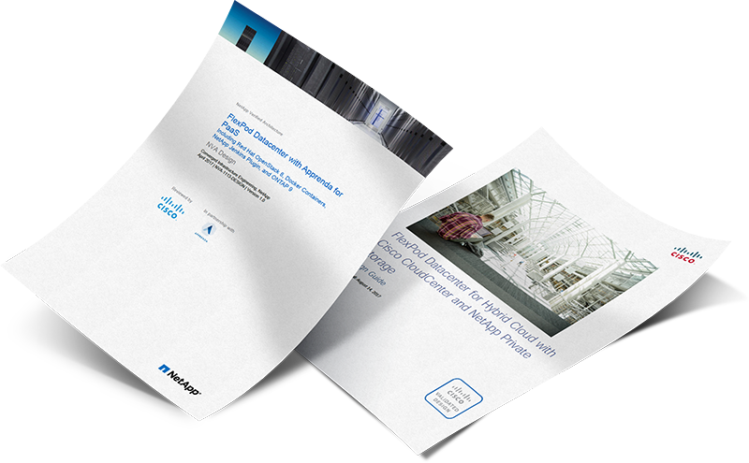
Powering the Most Demanding Applications
New workloads
Artificial Intelligence / Machine Learning
Vertical Apps
  Healthcare: Epic, Meditech
Continuous Application Updates
Oracle 12c R2
SAP HANA
SQL Server 2017
Citrix XenDesktop
VMware Horizon View

Slide 17
Why FlexPod?
Latest FlexPod Innovations (Sept 2019 to Jan 2020)

Slide 18
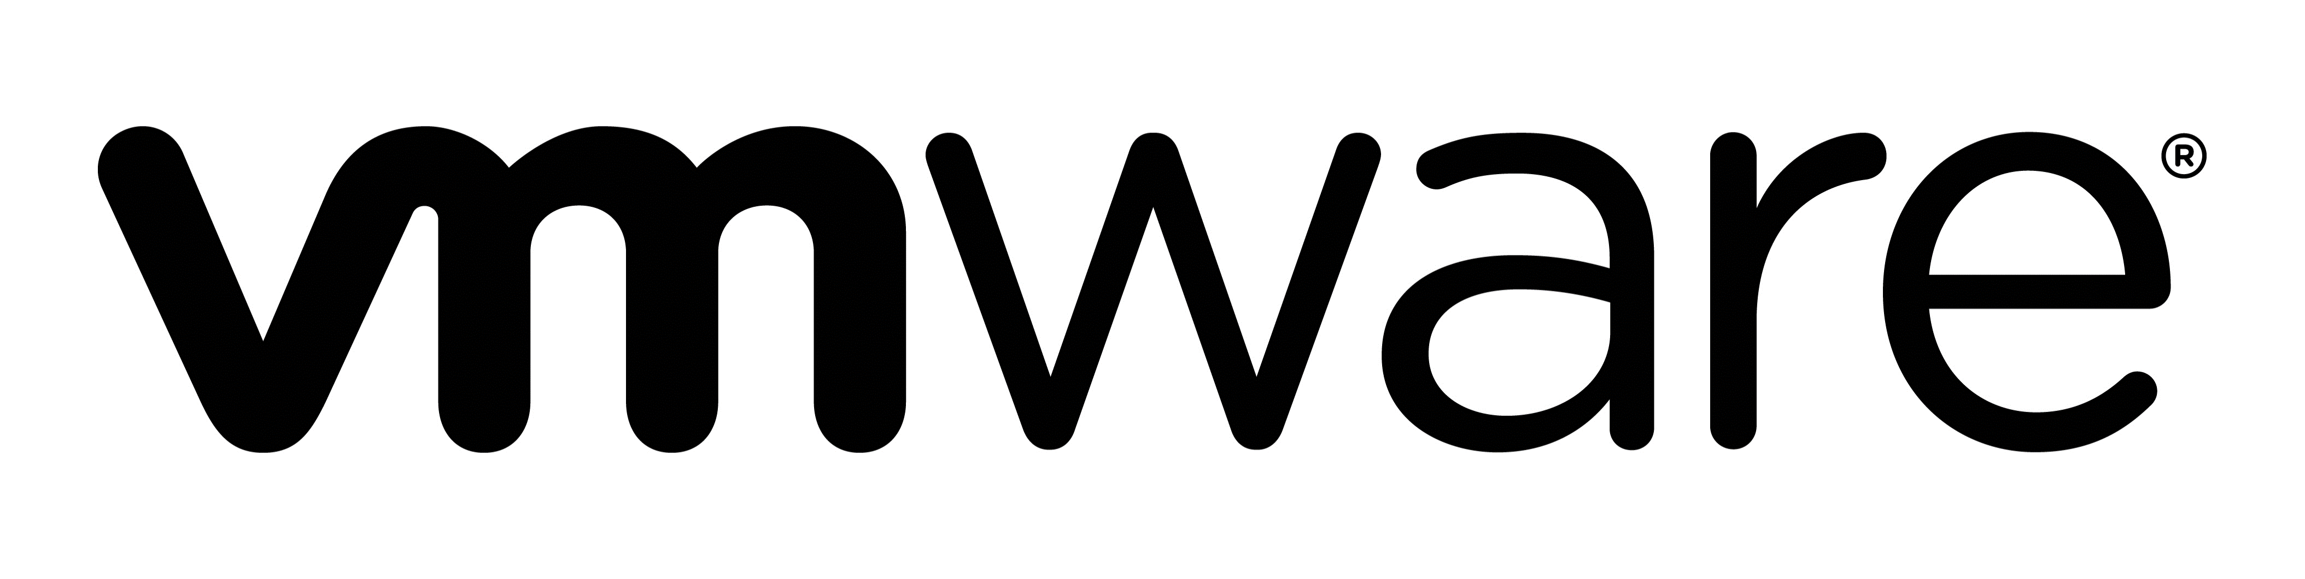
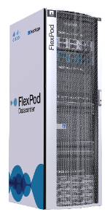


Latest FlexPod Innovations
Platform innovations
FlexPod Datacenter solution for the most recent VMware vSphere update (CVD)
Unmatched Versatility
Latest SAP HANA software running on the most current FlexPod hardware and software (CVD)
Platform trusted worldwide
CSA configuration assurance and lifecycle management including support of Cisco ACI networking, end-to-end NVMe, MetroCluster awareness
Notes:
CVD – Cisco Validated Design, TR – NetApp Technical Report
GA Expected CY2020
Storage tiering to cloud for FlexPod with FabricPool
Latest SAP HANA software running on the most current FlexPod hardware and software
FlexPod Datacenter solution for latest vSphere update and hardware refresh with NetApp ONTAP 9.6, Cisco UCS 4th Gen, VMware vSphere 6.7U2
ROBO FlexPod VMware solution that leverages the entry-level C190 flash system, and UCS C220 rack server
FlexPod hardening and best practices against ransomware
CSA configuration assurance and lifecycle management including support of Cisco ACI networking, end-to-end NVMe, MetroCluster awareness

Slide 19
Latest FlexPod Innovations
Platform innovations
Best in class performance of modern applications:
  3x better VM performance, 2x better VM density with Memory-Accelerated FlexPod
  End-to-end NVMe driving 40% better performance than all flash
AI/ML Full Stack CVD for Nvidia T4 and V100
  Portfolio of AI/ML Solutions from Data Preparation to Training/Learning to Inferencing/Deployment
  Includes extensive testing for both Nvidia V100 and T4 Card
Unmatched Versatility
Storage tiering to public cloud for FlexPod with FabricPool (TR)
ROBO FlexPod VMware solution that leverages the C190 flash system, and UCS C220 rack server (CVD)
Platform trusted worldwide
FlexPod hardening and best practices against ransomware (TR)
Notes:
CVD – Cisco Validated Design, TR – NetApp Technical Report
GA Expected CY2020
Storage tiering to cloud for FlexPod with FabricPool
Latest SAP HANA software running on the most current FlexPod hardware and software
FlexPod Datacenter solution for latest vSphere update and hardware refresh with NetApp ONTAP 9.6, Cisco UCS 4th Gen, VMware vSphere 6.7U2
ROBO FlexPod VMware solution that leverages the entry-level C190 flash system, and UCS C220 rack server
FlexPod hardening and best practices against ransomware
CSA configuration assurance and lifecycle management including support of Cisco ACI networking, end-to-end NVMe, MetroCluster awareness

Slide 20
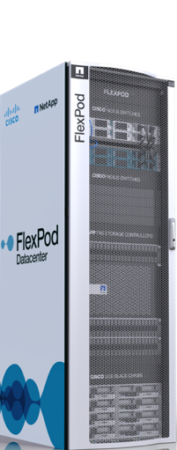

The First End-to-End NVMe CI Solution
High performance, ultra low latency for your most demanding apps compared to the fastest AFF systems
Deliver up to 55% more throughput performance on Oracle than all flash
Reduce Oracle latency by up to 25% for existing workloads
Decrease CPU utilization up to 35%
Upgrade at almost no cost from FC on array and MDS FC switch
Lower software costs due to less CPU utilization
NVMe capable UCS servers
NVMe/FC
NVMe capable
MDS FC switch
NVMe/FC
Storage with NVMe flash and NVMe/FC
Notes:
https://www.cisco.com/c/en/us/products/collateral/servers-unified-computing/ucs-b-series-blade-servers/whitepaper-c11-741907.html
In a VDBench Simulated Oracle Workload at 80% Random Reads and 20% writes Test Results, FlexPod with end-to-end NVMe showed:
At least 25% lower latency is seen at ~700K IOPs
56% increase in throughput is seen at ~300 microseconds.
35% decrease in CPU utilization
QLogic – Check in NVMe Primer if we even support Qlogic:

Slide 21
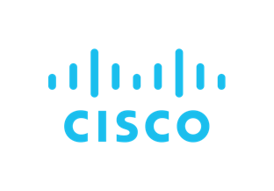
AI/ML Strategy
Focus on Full Data Life Cycle, Simplicity, and
Manageability
Training
Model Dev
Model Validation
Model Execution
Full portfolio for all AI/ML computing needs
Data
Validated solutions with technology partners
Source & Aggregate
Cleanup
Transformation
Natural extension of existing computing environment
Deployment/
Inference
Application runtime at source of demand
Notes:
You want to make sure that the software you are going to run in the data center is pre-validated. The third. They will be all managed by the data

Slide 22
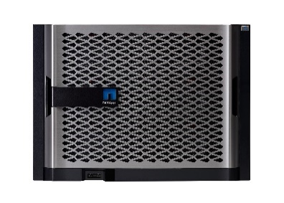
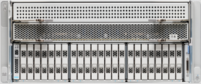
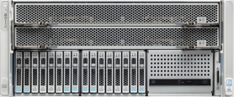
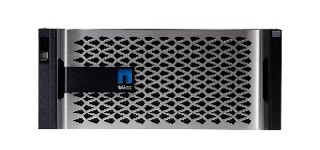
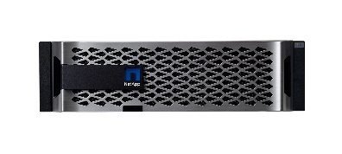


FlexPod for AI/ML/DL: Portfolio of Solutions
Focus on full Data Life Cycle, Consistent Operational Model with UCSM and ONTAP
Data
Source & Aggregate
Cleanup
Transformation
UCS Servers
with Nvidia GPU
Most Space Efficient
Internal SSDs
Most Flexible
External SSDs
Cisco UCSM
NetApp ONTAP 9
Training
New
New
Model Dev
Model Validation
Model Execution
High-end
UCS C480 M5
6x PCIe T4/ V100
AFF A800
Extreme
Performance
AFF A700s
Compact
Design
AFF A700
Modular design
UCS C480 ML M5
8x SXM2 V100 with NVLINK
Midrange
UCS C240 M5
6x PCIe T4/ V100
AFF A300
Deployment/
Inference
Entry-level
New
UCS C220 M5
2x PCIe T4
AFF A220
Application runtime at source of demand
Notes:
FlexPod now offers a portfolio of AI/ML solutions that serve all parts of the AI/ML market from the very small the very large. Some of the advantages that FlexPod brings to AI are:
Get started in AI faster: eliminate guesswork with a validated reference architecture that detangles design complexity. With an AI/ML Cisco Validated Design you are up and running faster. A FlexPod AI CVD is an IT cookbook or blueprint that reduces risk, increases security, delivers end-to-end availability and ensures that you can get your workload up and running without worrying how to setup your infrastructure.
Intelligently manage data across the pipeline from edge to core to cloud: FlexPod AI leverages the NetApp Data Fabric to unify data management across the pipeline with a single platform. Use the same tools to securely control and protect your data in flight, in use, or at rest and meet compliance requirements with confidence. With the NetApp Data Fabric is ONTAP® data management software your data and data management strategy is consistent from the edge to the core to the cloud. This virtual platform allows data to be stored the same way it is stored on in-house NetApp systems in the cloud or on the edge. The continuity in ONTAP data services enables administrators to move data where and when it is needed without requiring conversions. NetApp has also moved to the edge with its ONTAP Select software defined storage
Scalability and Data Integrity: FlexPod AIs also provide secure separation of resources and achieve data integrity for the AI/ML environment, a dedicated Storage Virtual Machine (SVM) was created for an AI tenant. With the massive scalability created with Cisco Nexus 9000 Series Switches and ONTAP software and FlexGroup volumes, you can deploy environments that scale to 20 PB and beyond in a single namespace to support very AI large data sets, resulting in better data models. FlexGroup volumes have virtually no capacity or file count constraints outside of the physical limits of hardware or the total volume limits of ONTAP.
Container Orchestration: As organizations accelerate their rate of data collection, the need to introduce automation around that data becomes apparent. Using containers is one way to achieve this; it enables faster deployments by separating applications from the OS and device-driver layer dependencies. Efficient and easy data management is central to reducing the time-to-train.
Trident™ is a NetApp dynamic storage orchestrator for container images that is fully integrated with Docker™ and Kubernetes™. Combined with NVIDIA GPU Cloud (NGC) and popular orchestrators like Kubernetes or Docker Swarm, Trident enables customers to seamlessly deploy their AI/DL NGC Container Images onto NetApp Storage allowing an enterprise grade experience for their AI container deployments. This includes automated orchestration, cloning for test and dev, NGC upgrade testing using cloning, protection and compliance copies and many more data management use cases for the NGC AI container images.
Data traffic in DL can consist of millions of files (images, video/audio, text files). Network File Systems (NFS), are ideally suited for delivering high performance across a diverse range of workloads; they handle both random and sequential I/O well. When used with ONTAP FlexGroup volumes, NetApp AFF can deliver high performance for small file workloads spread across storage systems.
Partner Ecosystem: FlexPod has hundreds of channel partners worldwide that have a deep expertise in all aspects of deploying and scaling FlexPod AI. No matter the size or needs of your business, FlexPod has a channel partner who can guide and assist you for all your FlexPod AI needs.
Performance: NetApp AFF systems keep data flowing to DL processes with the industry’s fastest and most flexible all flash storage, featuring the world’s first end-to-end NVMe technologies. The A800 is capable of feeding data to FlexPod AI systems up to 4 times faster than competing solutions*
* Read throughput of up to 300GBps per all-flash cluster versus 75GBps from a leading competitor

Slide 23


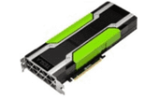


Nvidia T4 GPU Qualified Across Portfolio
High-end
UCS C480 ML M5
8x SXM2 V100 with NVLINK
UCS C480 M5
6x PCIe T4/V100
Midrange
UCS C240 M5
2x PCIe V100/
4x PCIe T4
Entry-level
UCS C220 M5
Nvidia 2xPCIe T4
AFF A800 Extreme Performance
AFF A700s Compact Design
AFF A300
AFF A220

Slide 24




FlexPod FabricPool with Primary Data
Auto Volume Tiering Policy
Before
After
Tier Cold Data to the Cloud and Save
Auto volume tiering policy tiers all inactive (cold) blocks
31-day default cooling period
Adjustable cooling period
(2 to 63 days)
Primary Cluster
Primary Cluster
Provisioned storage
Active data
Snapshot™ copies
S3
Inactive data

Slide 25
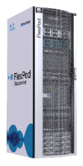






FlexPod FabricPool Lowers TCO
Performance
Tier
On Premises
Public Cloud
Private Cloud
Cloud
Tier

Slide 26





FlexPod Ransomware: Prevention and Mitigation
Pre-emptive Hardening, Recovery and Remediation
Ransomware recovery.
Quickly restore after attack with NetApp Snapshot™
Policy-driven data retention. Automatically enforce data retention with NetApp SnapLock®
Data Recovery.
Near instant remediation with NetApp SnapRestore ®
Data
Malware prevention. Antivirus and third-party integration through NetApp FPolicy™
Encryption.
On disk, data is secured and can be purged
26
© 2018 NetApp, Inc. All rights reserved.
Notes:
As a data management operating system, FlexPod with NetApp ONTAP has many fantastic capabilities that help our customers robust hardening against Ransomware. Our customers can keep the original data intact, but generate a FlexClone copy that can have all personal data stripped from it and use that for data processing. They can keep the full value of their data by maintaining that original copy. With SnapLock, they can have a predefined and enforced data retention policy. Through the integrations with FPolicy, third-party antivirus can prevent malware from taking root. The ONTAP Snapshot and SnapVault capabilities have been used by our customers to quickly recover after a ransomware attack. SnapMirror provides the proven disaster recovery mechanism with full replication. And last but not least, ONTAP provides encryption for data when it’s transmitted over the network or when stored on disk and can purge that data cryptographically.
Fieldportal.com : GDPR and ONTAP Quick Guide

Slide 27



FlexPod Infrastructure with vSphere with C190 and C220
Targeted at Small to Mid-size Businesses
ROBO/ Small Enterprise
Cisco UCS C220 M5 server
Cisco Nexus 3K switch
Offers pre-validated capabilities for Remote Office, Branch Office and Small sized Enterprise
NetApp AFF C190 All-Flash Array
Simplify Deployments
Offers reference architecture that simplifies deployment
Embrace Innovations
Stay current with technology innovations from NetApp and Cisco
Notes:
FlexPod

Slide 28






FlexPod with vSphere – AFF C190 and UCS C220
Same FlexPod Benefits: Cloud-connected, Multi-protocol, Efficient, Reliable, One Call Support, Easy Setup
Modernize your Infrastructure with AFF at affordable price
Accelerate applications by 10x with the same $/GB as SAS 10K HDD
Cisco UCS C220 M5 server
Cisco Nexus 3K switch
NetApp AFF C190 All-Flash Array
Solution for your transition to a hybrid cloud environment
Use one set of tools to manage and protect data, wherever the data is
Run optimally on a single system for both file and block application
Smart system with built-in efficiency

Slide 29

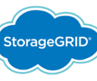

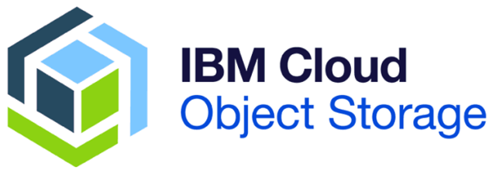


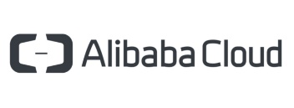
Storage Tiering FlexPod Cold Data to Public Cloud
Leverage FabricPool: Keep only hot data on your AFF C190 flash system
Reduce primary flash storage needs by >50%
  Decrease the size of new system configurations
  Reclaim capacity and consolidate more workloads on existing systems
Simple setup and automated management
    Get end-to-end security and encryption
    Get reporting on inactive data
Many tiering options
    Cloud: Amazon, Microsoft, Google, IBM, Alibaba
    On-Premises: NetApp StorageGRID, IBM (Cleversafe)
Promotion: First 10TB FabricPool term license at no cost
Hot
data
Primary Flash System
Cold data
Private Cloud
Public Cloud

Slide 30
Monitor with Converged Systems Advisor
Enabling Partners to improve lifecycle management of FlexPod deployments
  Quickly validate FlexPod configuration at deployment
  View customers’ FlexPod from a single-pane dashboard
  Report on inventory and configuration health
  Learn more about CSA including how to download the CSA Agent
Notes:
CSA helps partners deploy FlexPod and stay better connected throughout its lifecycle.
CSA has a Partner Portal with Deployment Validation and management capabilities.
Partners can view all of their FlexPod customers in a centralized cloud-based dashboard:
Enabling them to see continuously updated health status and configuration alerts
CSA can be leveraged as a tool in partners’ managed service offerings around support and lifecycle management
Partners can leverage free deployment validation:
To verify the configuration of the FlexPod during deployment
To generate a comprehensive report of all inventory and configuration health (also, a nice leave-behind for the customer)
To get started with CSA:
Simply download the CSA agent from https://csa.netapp.com
Reference the CSA ‘getting started’ documentation
https://docs.netapp.com/us-en/converged-systems-advisor/task_getting_started.html

Slide 31
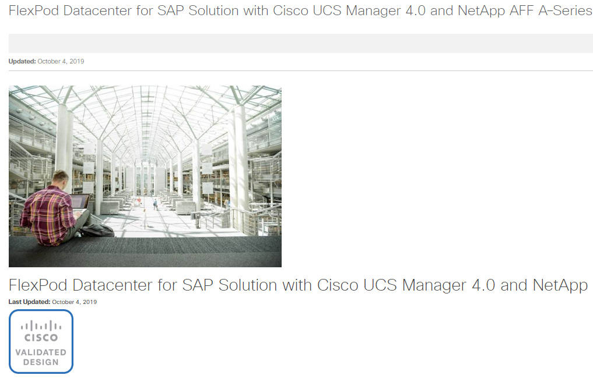
Reduce risk with latest SAP HANA Solution
Guides for high-quality, repeatable deployments
Design guides
Deployment guides
Technical specifications
Application workloads
Solution guides
Sizing guidance
Collaborative support between Cisco and NetApp covered by Cisco Solution Support

Slide 32
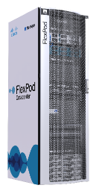
Power Modern AI and SAP HANA with FlexPod
FlexPod Datacenter for SAP Solution with Cisco UCS Manager 4.0 and NetApp AFF A–Series Design Guide
Optimize operations with ONTAP 9.6
with SnapCenter, SnapMirror, LaMa integration for asynch backup, recovery, and cloning of multiple databases and other application workloads
Enhance performance of enterprise apps
with AFF A-Series storage with NVMe; next-generation, UCS M5 with Optane; Nexus 40GbE switches.
Dramatically reduce data center costs
with industry leading data center efficiencies – capacity saving guaranteed
Operate with confidence on a platform and partnership trusted worldwide
#1 converged infrastructure solution according to IT Central Station
Notes:
There are many innovations enabled by FlexPod as your foundational platform.
For example, FlexPod now supports interoperability with Google, Amazon AWS, Microsoft Azure and IBM for hybrid cloud deployments. FlexPod offers flexibility and enables you to work with your cloud vendor of choice so that you can choose what works well for your business.
We’ve talked a lot about getting data insights and FlexPod empowers you to gain insights 20 times as fast at 20% lower cost than other similar platforms. Getting insights fast allows you to reduce time to value and positively affect your bottom line quickly.
Applications that also enable you to get to data insights quickly include Artificial Intelligence and Machine Learning technologies. With FlexPod, you can easily access AI and ML tools to assist your data scientists mine data efficiently.
All of these innovations can be run with a 22% more efficient use of compute resources when using FlexPod.
One of the key benefits of FlexPod is how flexible it is and we will talk about that next.
<click>

Slide 33
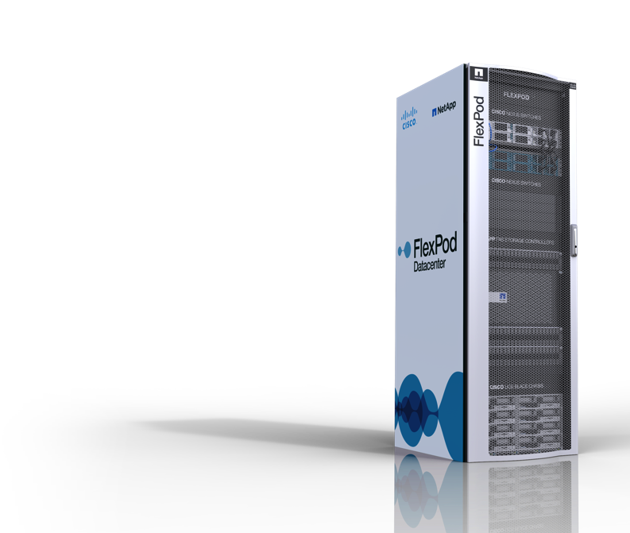
Resources:
Blog posts:
NetApp (Jan 22): FlexPod Adapts and Thrives in a Decade of Constant Change
Cisco (Jan 22): 2020: Kicking off 10 years of FlexPod Success
NetApp (Jan 23): Memory-accelerated FlexPod is the Royal Flush of high performance systems
White Papers:
New white paper: Introducing End-to-End NVMe for FlexPod
Infographics:
New Infographic: Turbocharge Your Data
New Infographic: 4 Ways FlexPod Forms the Foundation for Cisco and NetApp Success
Solution briefs:
Solution brief: Modernize Your Data Center with a Platform Built for Innovation
Solution brief: FlexPod All-Flash Solutions for SAP
Additional resources:
Web page http://www.netapp.com/flexpod
Web page https://flexpod.com/

Slide 34
Why FlexPod
FlexPod Value

Slide 35





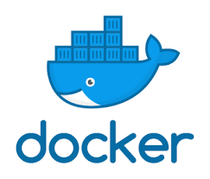

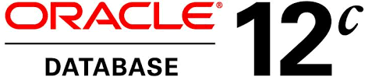
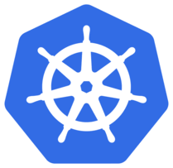


Power Modern AI and Enterprise Apps
Power the most demanding AI applications with infrastructure optimized for analytic workloads
Enhance performance of enterprise apps
with next generation compute, fabric and all-flash storage validated solution for latest modern applications
Dramatically reduce data center costs
with industry leading data center efficiencies – capacity saving guaranteed
AI
Confidently integrate new capabilities
with rapid validation of the latest technologies – AI, EHR, NVMe, cloud services, PMEM, GPUs, scale out flash, and more
Over 170 Validated Designs!
Notes:
There are many innovations enabled by FlexPod as your foundational platform.
For example, FlexPod now supports interoperability with Google, Amazon AWS, Microsoft Azure and IBM for hybrid cloud deployments. FlexPod offers flexibility and enables you to work with your cloud vendor of choice so that you can choose what works well for your business.
We’ve talked a lot about getting data insights and FlexPod empowers you to gain insights 20 times as fast at 20% lower cost than other similar platforms. Getting insights fast allows you to reduce time to value and positively affect your bottom line quickly.
Applications that also enable you to get to data insights quickly include Artificial Intelligence and Machine Learning technologies. With FlexPod, you can easily access AI and ML tools to assist your data scientists mine data efficiently.
All of these innovations can be run with a 22% more efficient use of compute resources when using FlexPod.
One of the key benefits of FlexPod is how flexible it is and we will talk about that next.
<click>

Slide 36



Embrace cloud with confidence for unmatched versatility
Edge
Integrate advanced cloud services
with the only hybrid, multicloud CI stack
Core
Orchestrate across edge-core-cloud
to support modern workloads
Meet the needs of diverse workloads
with precision scalability and broad application support
Cloud
Non-stop operations for your applications
with built-in HA, data protection, and security–including multi-site HA
Notes:
Our experience has shown that each enterprise is unique. That is why our team across the world has worked tirelessly to create over 160 designs which have been thoroughly validated by customers over the years —ensuring your FlexPod will be configured to address the unique needs of your enterprise.
FlexPod supports core enterprise workloads and vertical specific applications—ensuring that your infrastructure is tailored to work seamlessly with the vertical applications you employ to compete in a competitive market.
As you manage the data pipeline, data mobility becomes top-of-mind. This is where FlexPod excels, by providing data mobility capabilities that meet an enterprise’s unique compliance requirements.
All this said, enterprises have experienced 56% faster time to market which tends to be the equivalent of 4 months reduction in the average lifecycle of Business Application Development.
While ensuring your enterprise stays versatile enough to grow market share and profitability, being able to trust that your data infrastructure will deliver is critical.
<click>

Slide 37




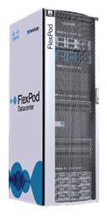
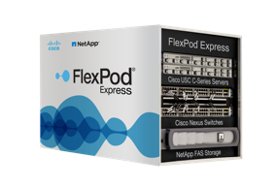
The Most Cloud Connected CI Platform
EDGE
ON PREMISES (CORE)
Cloud Services
IN THE CLOUD
Advanced AI/ Analytics
Enterprise Apps
General Apps
2
3
Cloud Services
1
Real-Time
DATA
FABRIC

Slide 38


The World’s Most Trusted CI Solution
Simplify your support experience
with full stack support from a single vendor
Operate with confidence
on a platform and partnership trusted worldwide
#1 Converged Infrastructure Solution
Continually optimize your operations
with cloud-powered intelligent, actionable insights
Streamline IT with managed services
that deliver a simple, cloud-like experience
Notes:
As your company ingests an unprecedented amount of data through the use of emerging technologies, you will begin to realize bandwidth and storage issues occurring more and more. To combat this issue, FlexPod enables companies to deploy resources 8x faster and scale-up to 10x faster non-disruptively. These capabilities are invaluable to stay competitive in the market.
FlexPod’s level of performance has taken the market by storm as demonstrated by its 5 quarters of consecutive growth as the fastest growing CI platform among major vendors.
Customers of ours are found all around the world, in over 9000 enterprises. These customers have already grown to realize the value that FlexPod provides as an enabler for their ecosystem.
What’s more, customers have been relying on FlexPod for over 8 years in their production environments. It has handled some of the most complex technical ecosystems to deliver when companies need it most.
<click>

Slide 39


Deliver a Better Customer Experience
One Call
One Vendor
Support
CSA
Active IQ
Intersight
Hypervisor
Management automation
Compute network
Intelligent services
Centralized management
Managed Private Cloud services
OpenStack, Ansible, Puppet, Chef
Compute OS
Health and best practice monitoring
Continuous configuration assurance
Predictive insights and guidance
Compute hardware
Storage network
Storage OS
Storage hardware
Notes:
What: NetApp Solution Support provides full stack support
Solutions Support for FlexPod extends beyond storage-only support to cover the complete FlexPod infrastructure
Why: Many customers prefer a single vendor to assume support responsibility for the full solution (reduced time-to-resolution)
Positioning: Ideal when the customer prefers single-vendor support
Differentiation: CSA software is included, offering unique value to both the customer and the support experience
Pricing: A layered product “on top” of SupportEdge Premium

Slide 40
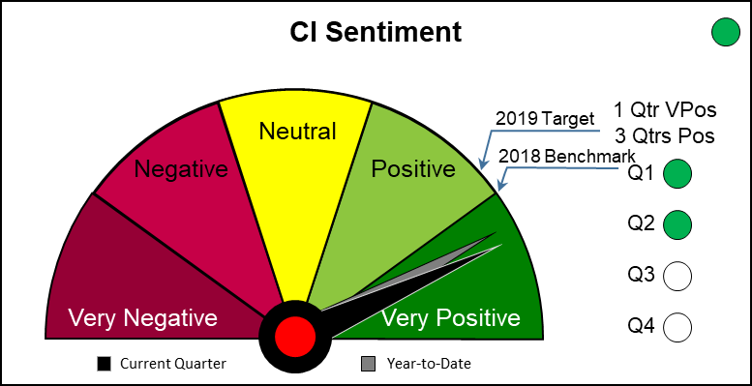
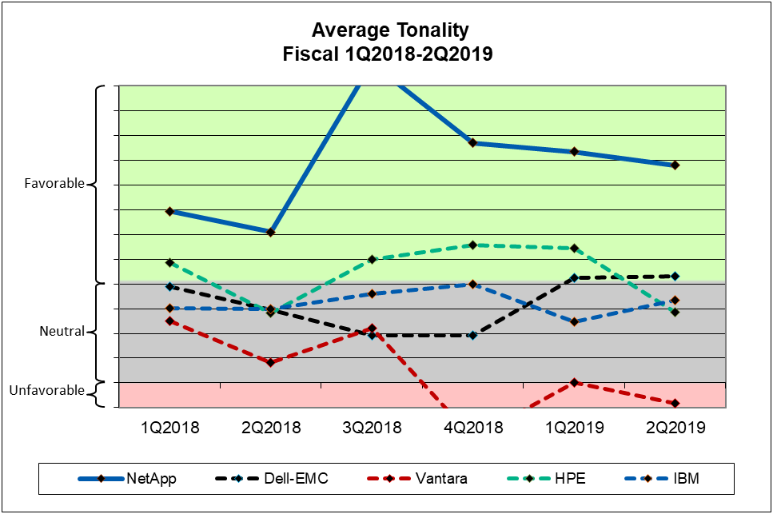
Industry Analysts Love FlexPod
Analyst sentiment as measured in published reports across major industry analysts
The Integrated Systems market covers solutions referred to as either converged infrastructure or integrated systems. Over the past year, this market averages about 30 reports per quarter with Gartner as the most significant firm followed by a tie between IDC and 451 Research.
Notes:
The Integrated Systems market covers solutions referred to as either converged infrastructure or integrated system. Over the past year, this market averages about 30 reports per quarter with Gartner as the most significant firm followed by a tie between IDC and 451 Research. ESG accounts for about 20% of coverage, though in the current quarter, ESG published a host of reports following the various analyst days and increased to almost 50% of coverage.

Slide 41
Why FlexPod is Number 1 with Customers
Rapid
Innovations
Customer
Experience
Cloud
Connectivity
History of rapid innovations including AI, all flash CI, private cloud, secure multi-tenancy, NVMe, cloud tiering, scale out flash
#1 Rated Converged Infrastructure solution in customer reviews on IT Central Station
FlexPod® is the only integrated infrastructure that simplifies edge to core to cloud and integrates with all major public clouds
Breadth and Scale
of Applications
Unified
Support
Success and Maturity
Scales to support the largest apps and validated with all major enterprise apps with over 170 validated designs.
One call support for the entire stack
9+ years strong and still the fastest growing CI solution

Slide 42
Customer case study: neteffect technologies
FlexPod performance: 10x faster applications
Background
For more than 25 years, neteffect technologies has gotten ahead by standing out. The company sets itself apart from its competition by turning the traditional approach to managed services on its head.
Business Benefits
With FlexPod® with AFF, internal applications now run up to 10 times faster than they did before, boosting productivity and efficiency. Maintenance windows have shrunk from hours to minutes, so it takes fewer resources to migrate virtual machines and spin up new systems.
Problem
As neteffect grew, it needed an IT solution that could scale both performance and capacity for its internal applications and its external netCare cloud offering.
Solution
neteffect technologies implemented FlexPod® Datacenter with All Flash FAS to boost performance for internal applications and expand its netCare cloud service.
Notes:
neteffect technologies shares their story of improving internal applications by up to 10 times faster with FlexPod.
Read more here:
http://www.netapp.com/us/media/cs-neteffect.pdf

Slide 43
Customer case study: Börse Stuttgart
FlexPod for Private Cloud: focus on innovations
Background
German stock exchange Börse Stuttgart manages thousands of financial transactions per hour. Retail investors rely on this exchange for super-low-latency trading in more than 1.8 million financial products. They can also trade cryptocurrencies using the BISON app, which is powered by Börse Stuttgart Group.
Business Benefits
Unlocks the power of data to accelerate investment innovation, minimize trading complexity, and keep pace with digital market opportunities
Supports current and future workloads and simplifies infrastructure management
Enables the exchange to handle the massive data throughput on the stock exchange efficiently, stably, and extremely quickly
Saves money by using NetApp FAS for workloads that don’t demand all-flash performance
Allows the exchange to focus on innovation for the future
Problem
Increasing trade volumes and inherent marketplace volatility, which can trigger unforeseen spikes in capacity requirements, requires modern technology for the exchange’s infrastructure to enhance its ability to scale.
Solution
The FlexPod® converged infrastructure platform forms the centerpiece of Börse Stuttgart’s private cloud to keep the exchange’s dynamic environment running smoothly by supporting all areas of the exchange, from virtual desktops on the trading floor to virtualized applications that generate billions of calculations per day.

Slide 44
Customer case study: TAS Networks
FlexPod running SAP HANA helps TasNetworks deliver unparalleled performance
Background
Tasmanian electricity transmission and distribution company TasNetworks needed to transition diverse applications into a single platform, following the merger of two separate electricity supply organizations in 2014.
Business Benefits
Allows the exchange to focus on innovation for the future
Easy to deploy hosts and do maintenance
Transformed our performance and efficiency, so we can focus on end-user services
Realize performance and availability improvements, while delivering a 75% reduction in data center footprint
Non-disruptively deploy, shift, and swap infrastructure and upgrade the network fabric
Problem
When the Tasmanian government created TasNetworks in 2014, it merged two separate electricity supply networks. This merger presented the challenge of integrating numerous legacy platforms from each company, including payroll, HR, and operational technology
Solution
To create the powerful platform they needed, TasNetworks selected FlexPod from NetApp and Cisco, which includes NetApp all-flash
storage arrays, Cisco networking, and the Cisco Unified Computing
System in a single deployment. They integrated this deployment by using Commvault Complete™ Backup & Recovery. By setting up a 100% virtualized environment, TasNetworks can scale services by augmenting the appropriate compute, storage, or network capacity within a single pod.
Notes:
https://customers.netapp.com/en/tasnetworks-flexpod-case-study/

Slide 45
Customer case study: Baylor College of Medicine
FlexPod value: $1.5 million hardware cost savings
Background
Baylor College of Medicine (Baylor) is helping to solve the most critical health problems of our time. Located in Houston’s Texas
Medical Center, the world’s largest medical complex, the researchers at Baylor tackle the complex questions of cancer, pediatric AIDS, aging, and much more.
Business Benefits
Contributes to better education and more timely discoveries as researchers move from idea to experiment in minutes
Accelerates grant funding cycle with service catalogs for fast, accurate costing
Allows researchers to focus on health sciences, not IT
Saves $1.5 million in hardware costs
Problem
Enhance medical research with on-demand self-service IT.
To conduct even more groundbreaking research and publish results faster, Baylor must enable its faculty and students to concentrate on their research without distractions.
Solution
Offer researchers easy-to-use infrastructure as a service by building a private cloud, “Discovery Cloud,” over the FlexPod® platform.
Notes:
Baylor College of Medicine has shared their story on saving $1.5 million in hardware costs with FlexPod.
You can read more here:
http://www.netapp.com/us/media/cs-6822.pdf

Slide 46
Why FlexPod for Partners
Optimized to grow long-term revenue

Slide 47

Why FlexPod is #1 with Partners
Successful partner profile matches FlexPod partners
Focus on Services
Sales Opportunity Areas
Partner-branded services drives profitability
New infrastrivit. 48%
Comp takeout 39%
Upgrade/expand 11%
Strong Attach Rate
Line of Business Selling
Every $1 brings an additional $7.41 of drag
Up 15% YoY
Represents 36% of revenues
Strategic Workloads
Cloud Revenue
1. All flash storage
2. CI
3. Backup and recovery
1. On-prem 36%
2. Off-prem 22%
3. Multi-tenant 19%
Notes:
Through the data gathered from this study, we were able to identify a worldwide group of our “Most Profitable” partners. Let’s look at the top findings from this group so that you can gain insights to what they are doing to drive profitability and leverage those success factors in your business.
Partners that focus on services and particularly partner branded services increases profitability.
For every $1 of NetApp they sell, they are attaching on average of $7.41 of additional revenue including hardware, software and services. This was an increase of 15% compared to last year.
The top three workloads are All Flash storage, CI and Backup and recovery.
These partners focus mostly on new infrastructure deals and and competitive takeouts – these kinds of sales engagements often include services that drive higher margins.
We continue to see that Line of Business owners have a say in IT decision. You need to work with a buyers in both Corp IT and Line of Business owners to close sales…
This year we included new data points about cloud revenue. The top 3 cloud offerings by revenue are on-prem, off prem and multi-tenant cloud. We did notice that across most of the geos there is a shift from on-prem to multi-tenant and off-prem.
Discussion points:
How does your company’s strategic workloads and vertical markets compare with those of the Most Profitable partners?
Is your company sales focus in line with the Most Profitable partners’ focus of competitive takeout and new infrastructure? What will it take to shift your company’s sales focus more towards competitive takeout and new infrastructure?
Do you see the LOB becoming an influencer or a decision maker in your customer’s IT investment choices? If yes, how does the conversation change?

Slide 48
Earn More with FlexPod
Cisco Partner Discount and Rebate Programs
NetApp Partner Discount and Rebate Programs
Account Breakaway
Up to 70% rebate
Refresh to the Future (R2F) Up to 8K reward
Growth Attainment Rebate
AMER only, 5% rebate
New Account Incentive
5% rebate, claimless
HPE Competitive
Up to 70% by selling UCS
SeedIT First-Time Buyer
Up to 70% rebate
Run to NetApp
Up to $120K rebate for partner transition services
Global Enablement Incentive
$5K specialization rebate
Nexus/ACI Bundle Promo
Build-in bundle discounts
Additional Program Incentives
JIP specific $TBD
  Visit the Incentives and Promotions Collection on Partner Hub

Slide 49
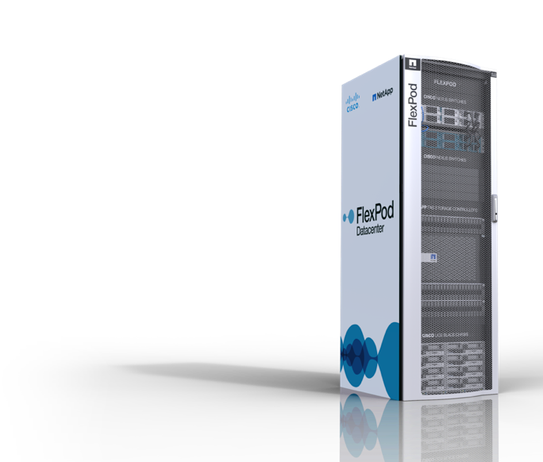
Is your FlexPod customer ready for a refresh?
FlexPod workloads are well-aligned to realize maximum benefit from flash, including:
Let them know it’s time to consider a refresh to FlexPod. It can drive their modern applications with faster compute, fabric and storage.
48%
administration time back*
3,000
FlexPod systems are in need of a refresh
76%
power and cooling savings*
63%
rack space savings*

Slide 50
Thank You

