Slide 1
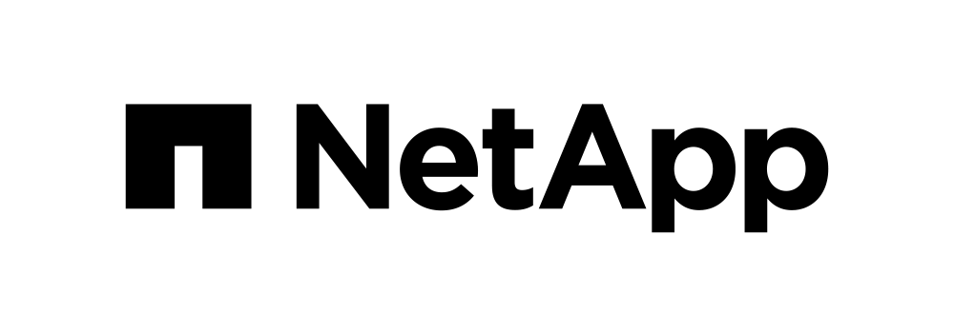
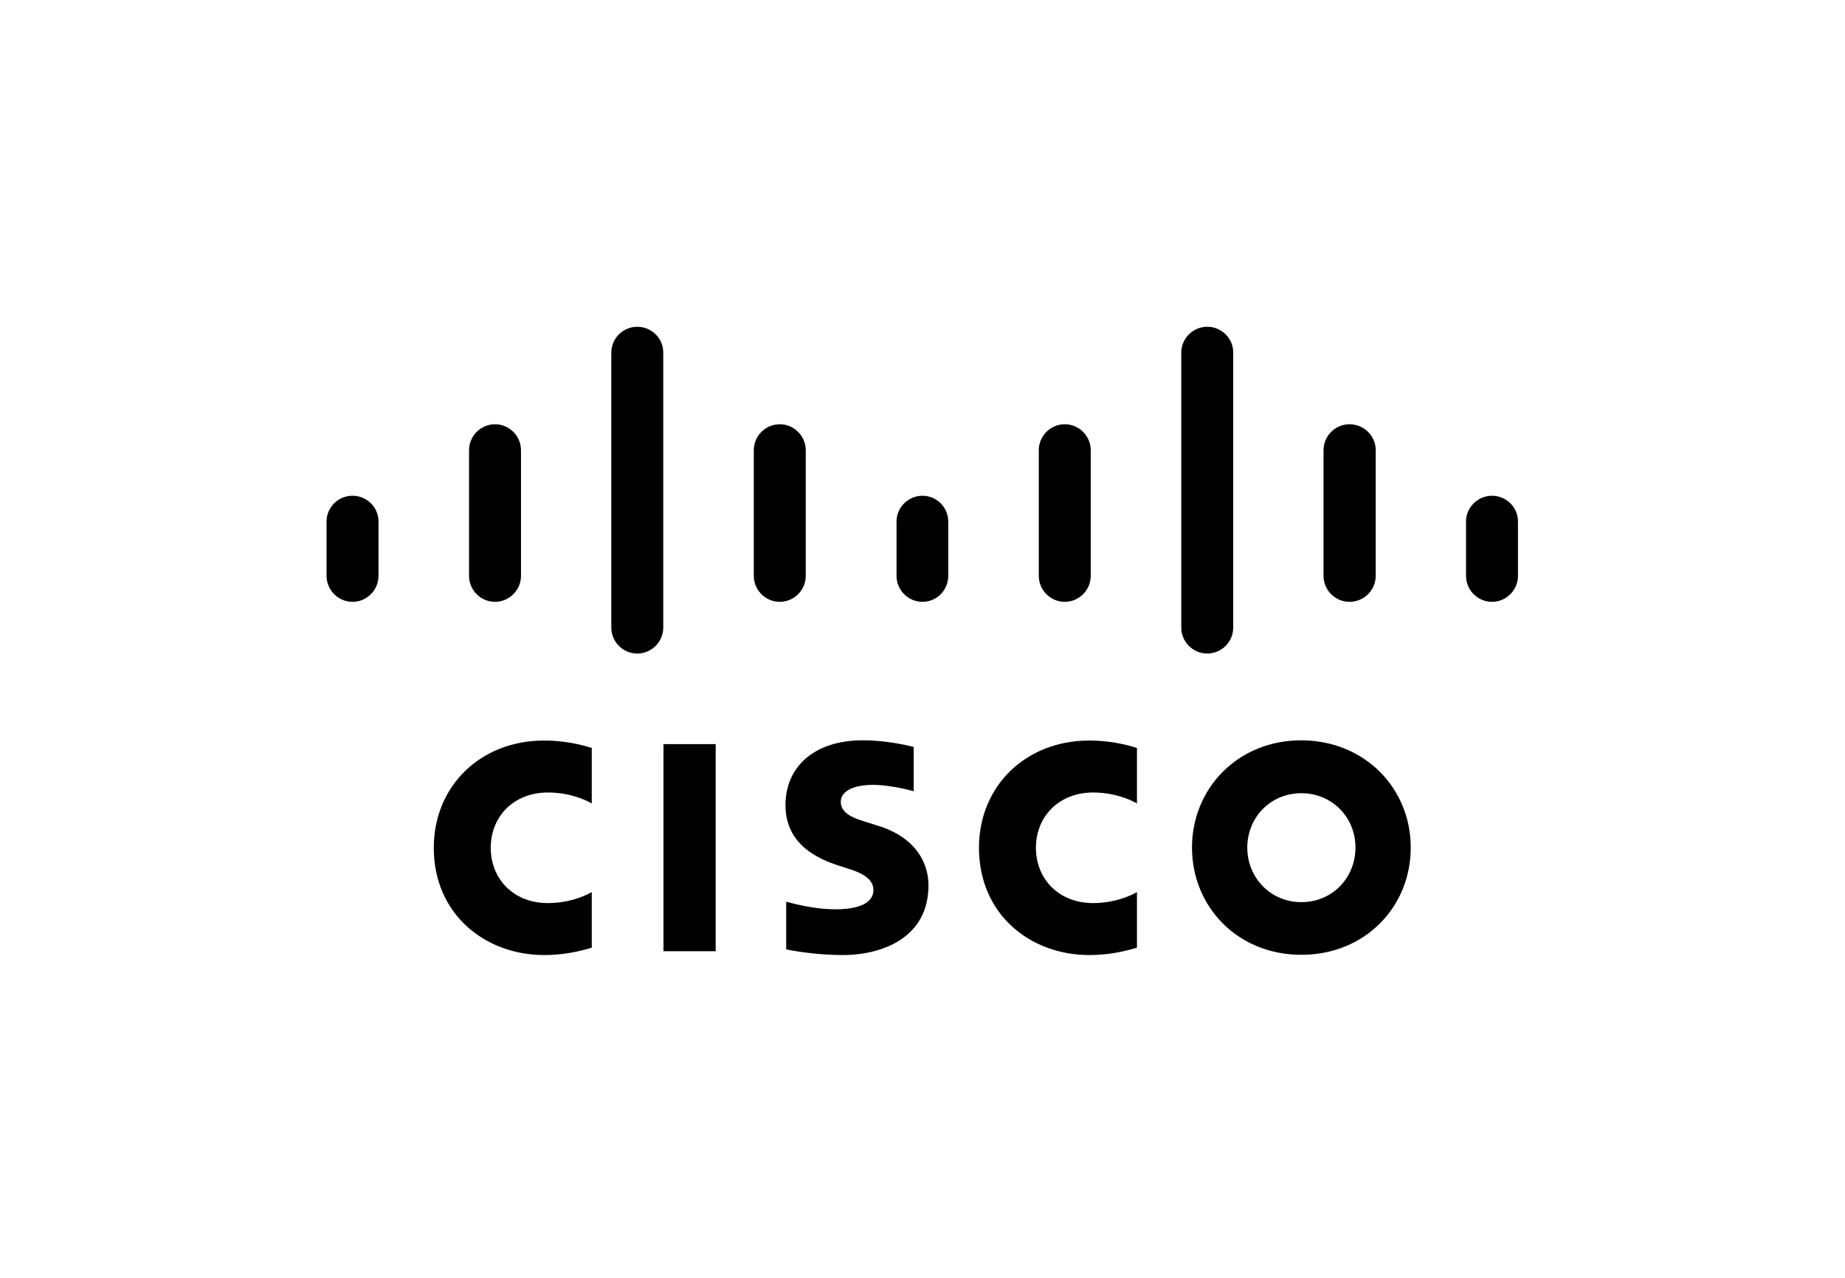
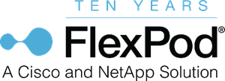
FlexPod Solutions for Private and Hybrid Multicloud Use Cases
Manash Kirtania
FlexPod Product Management
Chris O’Brien
Director, UCS Solutions Engineering
SPD-1470-1

Slide 3
Agenda
FlexPod® momentum
Cloud journey with FlexPod
FlexPod cloud solutions for use cases
Why you should consider FlexPod
Takeaways
Think outside of the box with FlexPod Hybrid
Notes:
So today we'll walk you through the FlexPod momentum, talk about what FlexPod offers in terms of the cloud journey that helps customers to adopt hybrid multi cloud, private cloud deployments. We’ll talk about the FlexPod solutions that we have in the truck. And we will also go through why you should consider FlexPod when it comes to building out private cloud or hybrid multi cloud use cases. And finally, we'll have few takeaways.

Slide 4
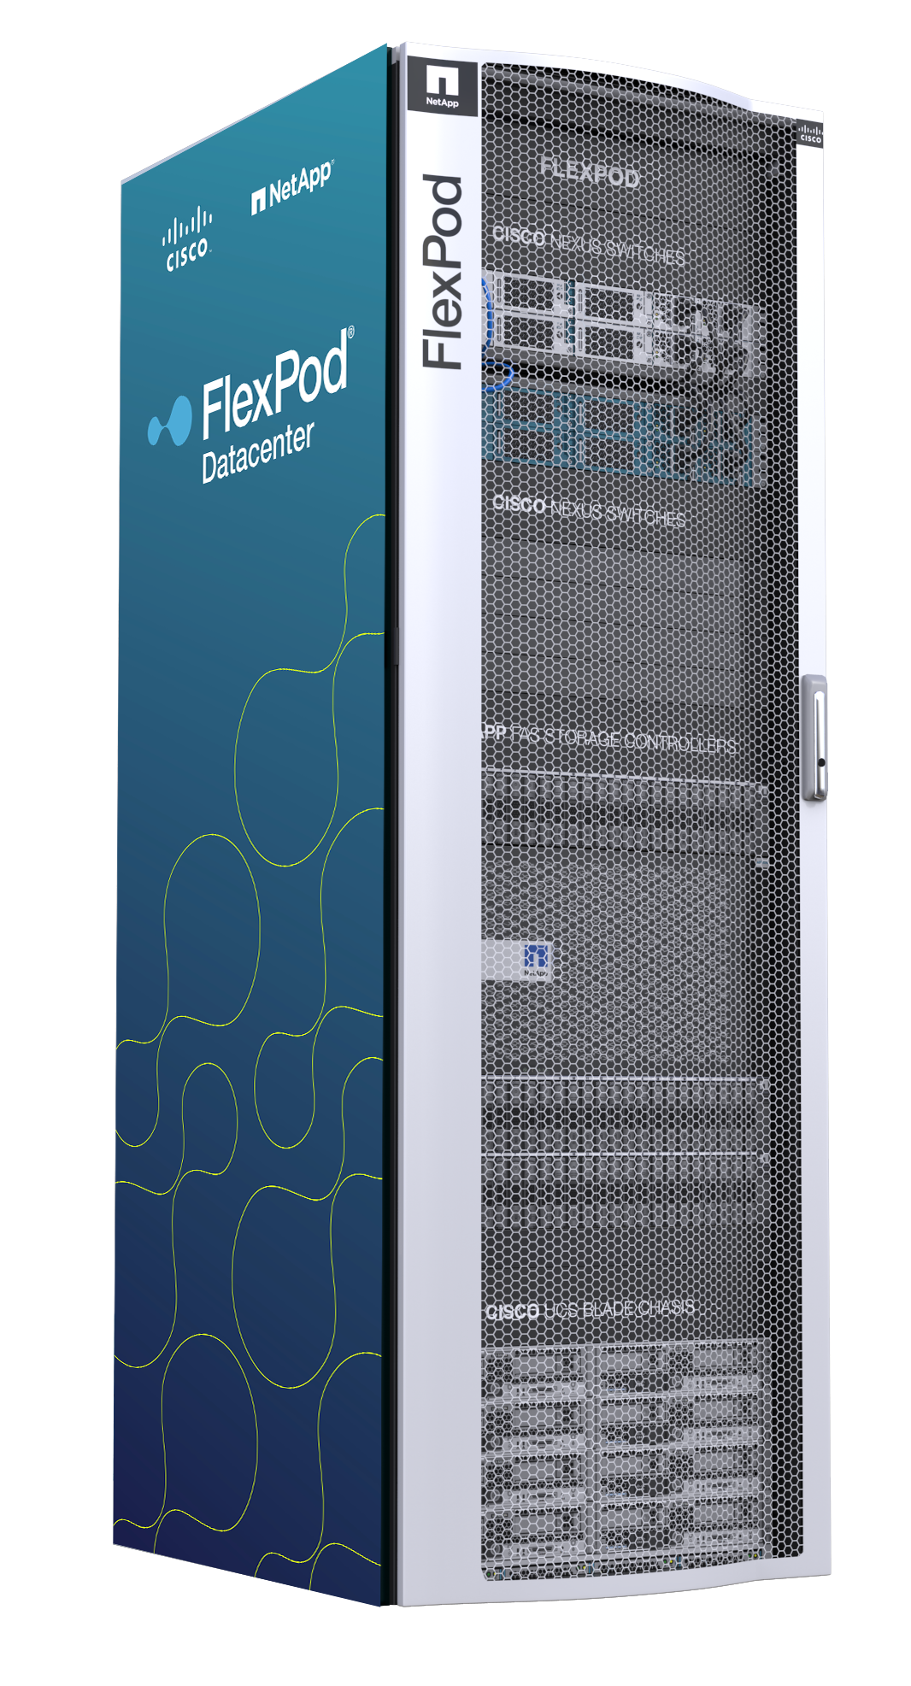
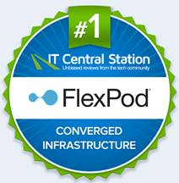

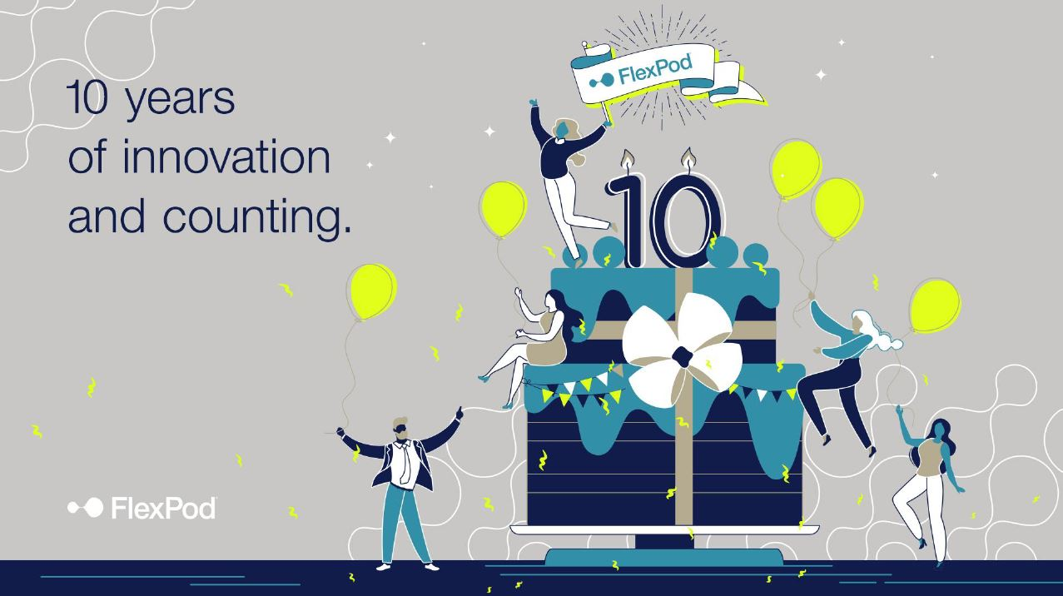
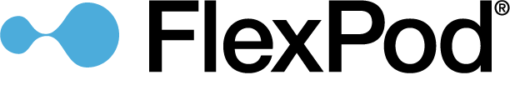
FlexPod Momentum
Success by the numbers
Converged infrastructure solution offered by Cisco and NetApp
Rated #1 CI Solution on IT Central Station
Celebrating 10-year partnership this year
Platform for innovation, unmatched versatility, trusted Worldwide
$14.0B+
9,500
175+
combined revenue to date
FlexPod customers
around the world
validated designs
6,500+
1,100
250
petabytes sold
partners serving 100 countries
person-years of joint engineering
10 years of evolving technologies, innovations, and solutions
The most cloud-connected CI platform
Notes:
Before we get into the details, I just want to take a quick minute to talk about FlexPod momentum. Because year 2020 is a major landmark for FlexPod. It is the 10th anniversary of Cisco and NetApp partnership for FlexPod. And over the last 10 years FlexPod has been established as one of the leading converged infrastructure platforms. It powered mission critical and business applications for a very large number of enterprise customers. In fact, FlexPod has more than 9500 customers worldwide. With a footprint of $14 billion+.
And over the years Cisco NetApp jointly invested in engineering, and it produced more than 175 validated designs that our customers can take, follow the steps, and quickly move on eliminating any guess works, and deploy FlexPod with confidence.
IT Central Station is in place where they track customer voices and opinions about various platforms solutions. And if you check IT Central Station, you'll see flexpod is the number one converged infrastructure platform. It is something our customers are saying, it's not just us saying. It is a platform for innovation, with unmatched versatility and is trusted worldwide. And it's also the leading platform… one of the most cloud connected converged infrastructure platform in the market today.

Slide 5
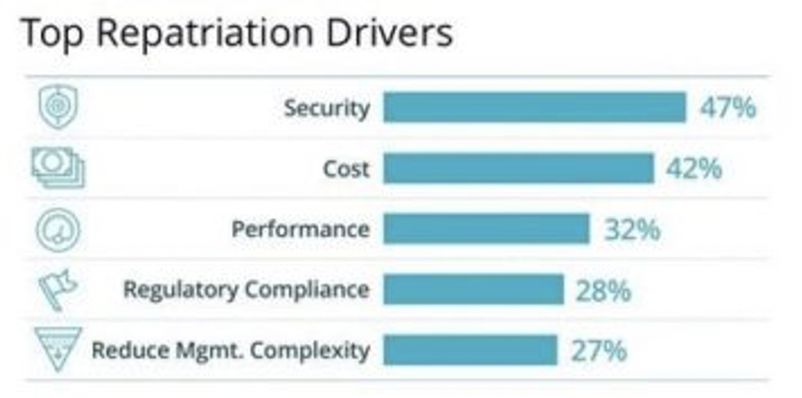
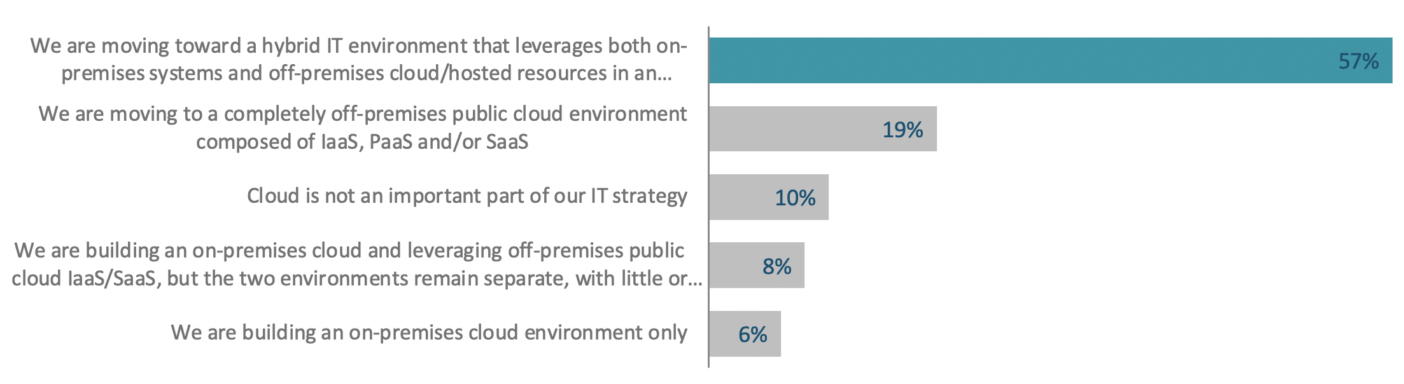
Customers Choose Right Workload at the Right Location
85%
57%
Cloud repatriation rate
(50% on-premises private cloud, 40% hosted private cloud, 10% on-premises non-cloud)
Enterprises adopting hybrid cloud
57% reported… We are moving toward a hybrid IT environment that leverages both on-premises systems and off-premises cloud/hosted resources in an integrated fashion
Q. In the last year, has your organization migrated any applications or data that were primarily part of a public cloud environment to a private cloud or on-premises environment?
Source: IDC’s CloudPulse Q119, June 2019, N=2211
Source: 451 Research, Voice of the Enterprise: Cloud, Hosting & Managed Services, Workload and Key Projects 2019, Base: All Respondents (n=571)
Notes:
Now, customers are looking at where they should run their workload. They're trying to find the right location. They want to make sure their workload is running with certain performance, certain criteria, at the right location. And historically they have run workloads on prem, but now with public cloud resources available, they are looking at hybrid multi cloud architectures. We know that public cloud is growing, but so is the cloud repatriation. According to IDC, 85% of the enterprise customers they surveyed reported that some workloads are coming back to on-premises private cloud, hosted private cloud, and even on-premises non-cloud infrastructure. Several reasons are driving this repatriation… there are security, cost, performance, regulatory compliance, reduced management complexity. So those are the top reasons why customers are thinking of bringing back applications to the on prem.
So a lot of enterprises are adopting hybrid cloud strategy. According to 451 research, 57% of the enterprise customers they surveyed are adopting hybrid cloud.

Slide 6
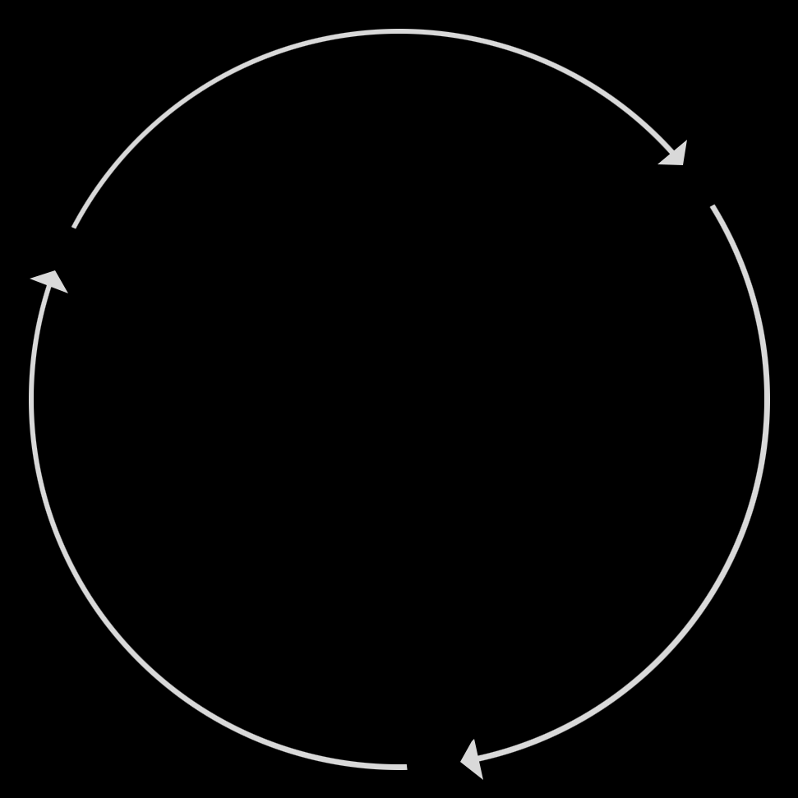





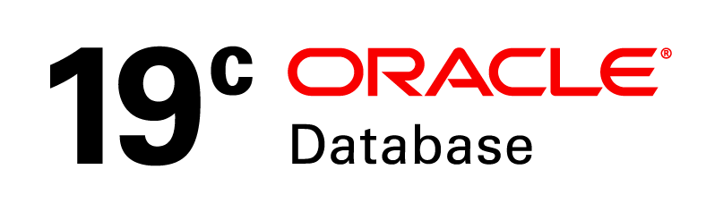


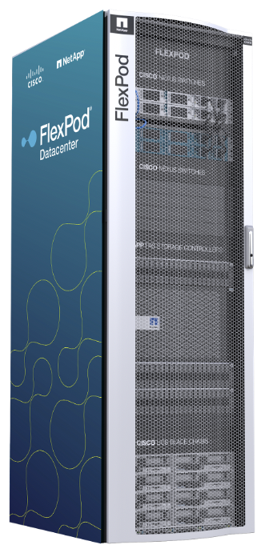
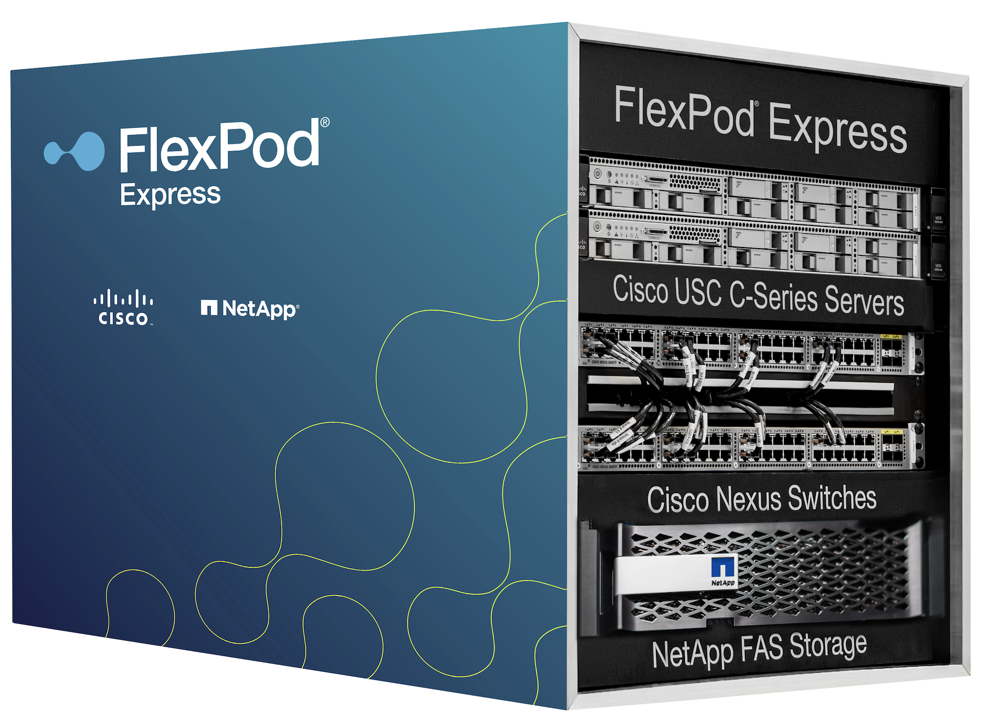
FlexPod Enables Edge-Core-Cloud with Data Fabric and Intersight
PUBLIC
CLOUD
MULTI-
CLOUD
Data
Fabric
FlexPod futureproofs the customer investments while adopting a hybrid multicloud strategy
EDGE
ON-PREM
CLOUD
ENTERPRISE IT
EDGE
ON PREMISES (CORE)
Cloud Services
CLOUD
Advanced AI/ analytics
Enterprise apps
General apps
Healthcare apps
VDI
Remote working,
3D graphics visualization
1
2
3
EHR/PACS
Hybrid multicloud
one experience across clouds
Real-Time
DATA
FABRIC
Power enterprise and modern apps
to meet increasing demands
Deploy infrastructure innovations from Cisco and NetApp® in action
Secure and protect data across
hybrid multicloud
Notes:
One of the key properties that make FlexPod perfect for Edge to Core to Cloud and hybrid multi cloud deployments is the data fabric. Data Fabric is an architecture that allows you to seamlessly move data across locations.
In addition, Intersight can manage FlexPod across locations as well.
You can run your mission critical and busines applications in the data center core, extend those to Edge locations, take advantage of Public Cloud resources and seamlessly move application and data wherever you need them.
With FlexPod, you can take advantage of Infrastructure innovations from both Cisco and NetApp, modernize your applications and deploy hybrid cloud environment.
======
Now, one of the key component when you build hybrid cloud hybrid multi cloud architecture with FlexPod is the Data Fabric. And this gives you the ability to move data from edge to core to cloud in any direction.
Think of your applications, which you can now move, because of the cloud native architectures, cloud first strategy etc. If you build applications in containers that gives you high portability and Data Fabric basically gives you the data portability. FlexPod platform can be managed through Cisco intersight.
Cisco Intersight is very strategic at Cisco. It is a cloud-based management platform. It as an opportunity at Cisco to really bring edge to core to colo, and also allow you to do some cloud functionality, not just on UCS but some of our other capabilities so we'll go into that in a few minutes. But if you marry Data Fabric with Cisco intersight, this is just going to make the hybrid cloud story for flexpod even stronger.

Slide 7

FlexPod Helps with Your Cloud Journey
Data center to private cloud
Hybrid cloud
CVD: OpenShift
WP: Cisco Container Platform
Private cloud
Connect data center or private cloud with public cloud services
CVD: Cisco CloudCenter
TR: Cloud storage tiering
TR: Cloud Insight*
CVD: OpenShift
WP: Cisco Container Platform
Multi-site business continuity and disaster recovery
Multi-site data center
CVD: Metro-cluster IP and ACI Multi-pod
Connect private cloud with public cloud services through colocation
Colo
CVD: Cisco CloudCenter
Setup, install, and deployment guidance
Managed private cloud program: private cloud with public cloud experience by a managed service provider
Data center
MPC
Infrastructure CVDs
ACI Multi-pod CVDs
Royalty-free Image source: https://www.dreamstime.com/royalty-free-stock-photo-road-to-cloud-computing-image27538705
Notes:
Where's the right location for my workloads? Well, I think a great starting point hopefully you'll think so too after this presentation is FlexPod. Now 10 years ago we started FlexPod, and we really were thinking about the data center, on-prem private cloud etc. and we've seen a lot of success. Over the past few years and what this slide is trying to capture, is that we were taking the FlexPod journey to hybrid cloud. And these different work efforts and different validated designs, etc. are really calling out the different capabilities that FlexPod has. So, we're gonna walk through a few of these use cases. But, you know, just rest assured that not matter what your journey to hybrid cloud, on-prem private cloud, or colo is, FlexPod can really take you there. So let's take a look at some of these different solutions

Slide 8
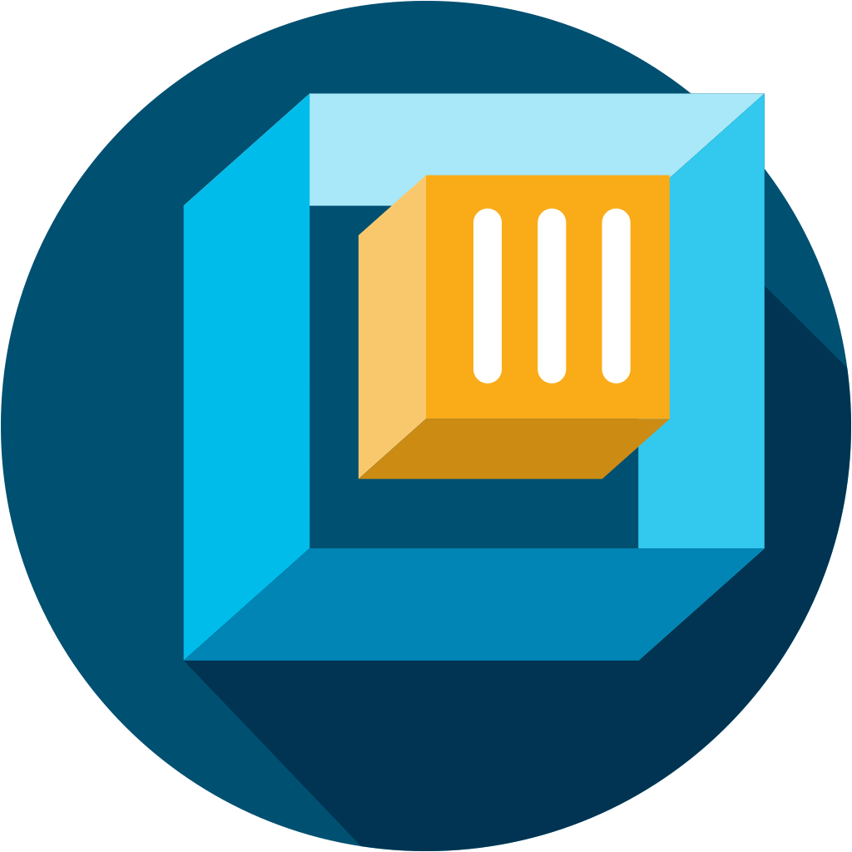
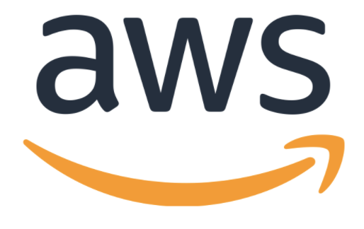
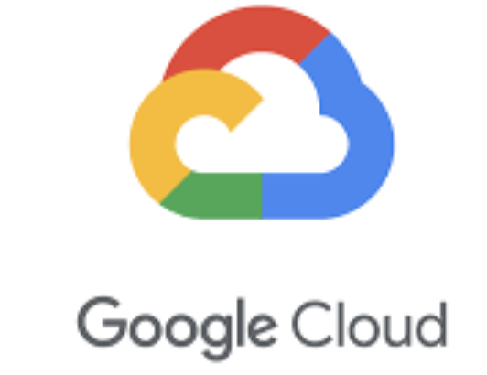

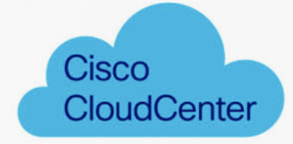

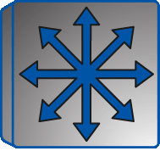

FlexPod Is a Foundation of Changing IT Landscape
NetApp® Data Fabric
Cisco Container Platform
NetApp Data Fabric
NetApp Private Storage
Edge/Core
Edge/Core
Edge/Core
Colo
Private cloud solutions
Red Hat OpenShift
Cisco Container Platform
Hybrid cloud solutions
Data Fabric with NetApp Cloud Volumes ONTAP®
Cloud tiering with Fabric Pool
Red Hat OpenShift
Hybrid cloud solutions
with colo
Cisco Cloud Center and NetApp Private Storage
Notes:
What you see here is some of the more recent work that we've done around private cloud, hybrid cloud solution as well as some of the colocation work and these are all environments that we see our customers adopting and are trying to enable that next gen application on top. So from a private cloud perspective, we've done a lot of work around Red Hat OpenShift and Cisco container platform. We’ve hybrid cloud deployments with cloud volumes on tap. We support fabric pool storage tiering solution. Obviously, Openshift has a hybrid capability and the Data Fabric with FlexPod can certainly complements it very well. And then the colocation story around private storage.

Slide 9
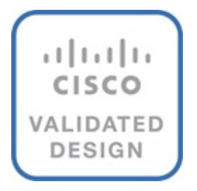
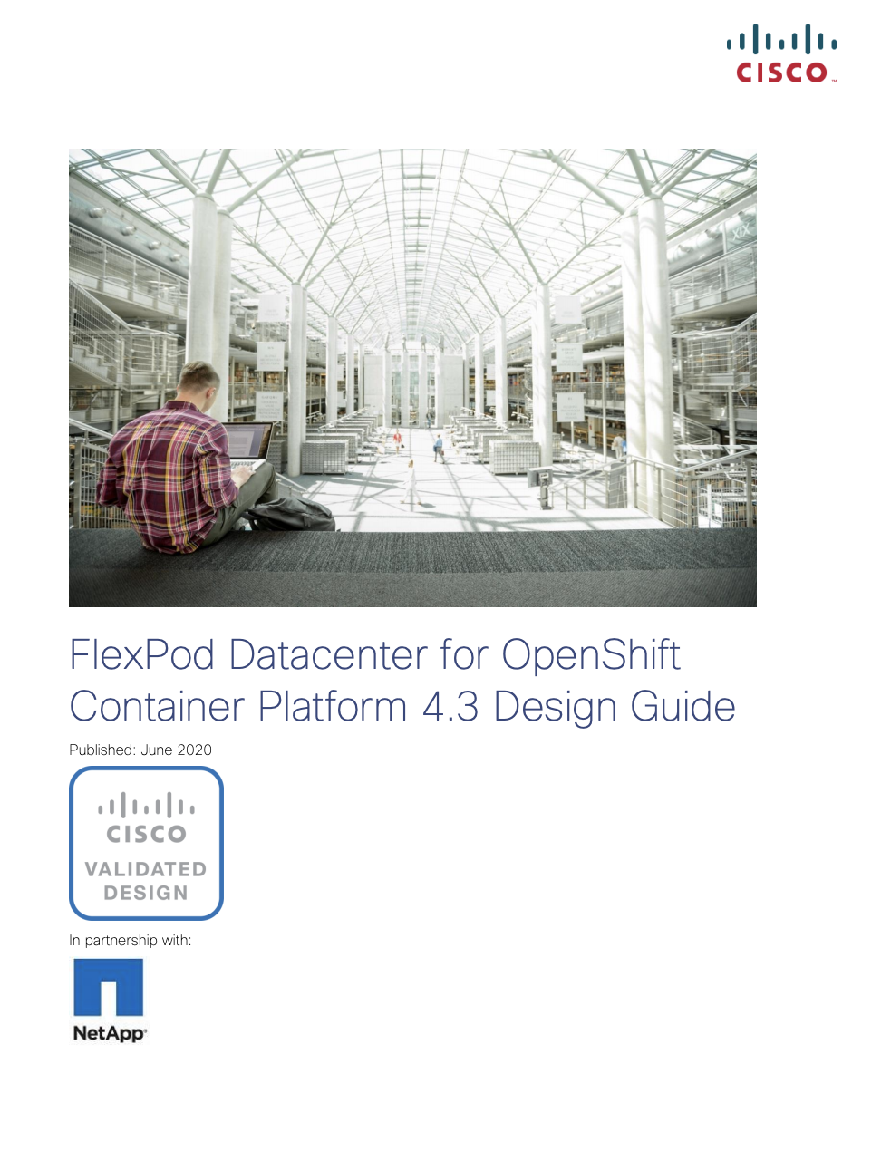

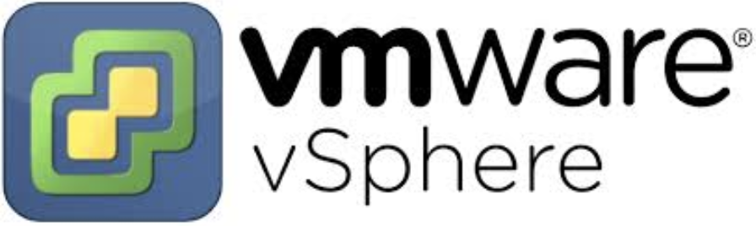

FlexPod Private Cloud Solution with RedHat OpenShift
A solid foundation for PaaS and DevOps
Modernize applications, develop cloud-native application—run legacy applications and modern workloads, both containerized and non-containerized
Faster time to market
Build private cloud and expand to hybrid cloud in future as needed
Future investment protection
https://www.cisco.com/c/en/us/td/docs/unified_computing/ucs/UCS_CVDs/flexpod_openshift43_design.html
Notes:
So, let's take a look at some of these new solutions. So, here you have our Openshift solution which is based on OCP 4.x release. We validated Openshift on top of Vmware. Obviously, FlexPod and VMware have seen a lot of success over the years, but there's two new components there. The first one I like to call out is that the persistent storage connection with containers are managed by Trident and have the right level of data services. And then on top of that we married that with Cisco Intersight. Cisco and NetApp are integrating ONTAP storage management using Cisco Intersight. You can certainly monitor your flexpod, do firmware management, take advantage of Cisco TAC and we'll go through that a few minutes. So the openshift platform was one of the first private cloud, container models that we've done on top of flexpod

Slide 10
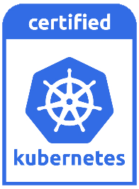

FlexPod Container Solution with Cisco Container Platform (CCP)
Runs on ANY infrastructure* as a lightweight self-hosted software
(optimized for UCS)
Automates the installation and deployment of self-service, 100% upstream K8s clusters
Includes all the necessary networking, storage, logging/monitoring, load balancing, and registry tooling
Cisco Container Platform
Integrates natively with public cloud Kubernetes services such as EKS, AKS and GKE (coming soon!)
Built for the enterprise with hardened security and enhanced availability features like multi-master and self-healing
Optimized for AI/ML workloads with multi-GPU support
Supported end to end by Cisco
Easy to acquire, deploy, and manage | Open and consistent | Extensible platform | World-class advisory and support
Notes:
Now, there's also a number of different flavors of Kubernetes and Cisco has an offering called Cisco container platform. This is fully supported, developed, and secured life cycle management application from Cisco. Cisco fully stands behind it as a company, and now we delivered this on top of flexpod. Key thing you should notice here is that the infrastructure, the UCS compute, NetApp FAS are all flash storage, the Nexus switching, the MDS SAN switching are the same for all container solutions. One thing we should really call out is that because we have the capability to take this very flexible infrastructure FlexPod, we can address different use cases and in this case we introduced a Cisco container platform in case someone wants a different flavor.

Slide 11
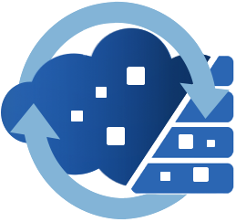


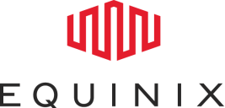
FlexPod Hybrid Cloud Solution with Cisco Cloud Center and NetApp Private Storage
Repatriation of an application from AWS and Azure to FlexPod®
Cisco Cloud Center deploys the same sample app on FlexPod, AWS, and Azure with a single blueprint
Cisco Cloud Center
AWS and Azure connected to NPS are a Dev/Test environment
Compute in both AWS and Azure able to access data in NPS without moving storage
FlexPod hosts the production workload and data
NetApp Storage
NetApp® SnapMirror®
Production
Dev/Test
https://www.cisco.com/c/en/us/td/docs/unified_computing/ucs/UCS_CVDs/flexpod_hybridcloud_design.html
Data is mirrored via SnapMirror from FlexPod to NPS controller, and vice versa
Notes:
So this was an actually a very interesting validation that we did. A couple years back Cisco acquired a company called Cliqr which became Cisco cloud center. This really allows you to do is essentially templatized applications VMware based or container based and then you can instantiate them wherever you need them to be in terms of either in the public cloud or in a colo location or an on prem environment on your FlexPod. So, with this solution if you look at it, we have multiple layers right. We were taking the Data Fabric which gives us mirroring technology, so we can replicate our data easily between the colo and the flexpod within the data center on prem.
But then we can also move the compute resources either from the flexpod which is running on UCS to the compute resources that might be available through high bandwidth capable link to whatever your public cloud may be. And to be clear cloud center support somewhere in the order of 19 public clouds. This flexibility, the ability to move data and application -- all stem from the same platform that we call FlexPod, so that your business, your developers can operate where they want when they want and you also get to choose where you position your application either in the public cloud or on on-premises. The advantages really stem from the flexibility and the integration that comes from FlexPod.

Slide 12






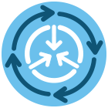
FlexPod Management Using Cloud-Based Cisco Intersight
  Intuitive experience
  Enhanced support
  Proactive guidance
  Secure and extensible
  SaaS delivered
Centralized management
Global policies
Comprehensive automation
Single pane of glass
Modernize your architecture
Simple to provision,
secure, and tune
Connect, scale, and configure wherever and whenever
SaaS consumption model
Free customers from care and feeding of management tools and eliminate upgrade dependencies
Seamless extensibility
Simplify management across technologies and geography
Continuous feature integration
Rapid development, delivery,
and customer feedback
Notes:
I wanted to just touch on our inter site management system. Cisco Intersight is a cloud-based platform. it allows you to consume our UCS compute resources from the cloud. It's all web based so it's very intuitive. It has enhanced support, and by that we mean that we provide connected tasks so TAC which is our technical assistance teams. So if you have a problem. You know the logs from your computer system can be loaded, tagged and then it can be run through some of our backend processes to provide accelerated remediation of the problem. It also allows us to learn so we have over half a million devices so we can provide very proactive guidance because we're continually learning from the data that we receive. And to be clear, it's a very secure environment meaning that we're collecting user data -- all within, the boundaries of of good etiquette and business.
Intersight has focused on Compute. But now, we are doing engineering work not only within flexpod but now between our Intersight teams and the ONTAP teams to bring a new level of ONTAP integration to Cisco Intersight. So, the key point here is that you know as you modernize your infrastructure, you also need to modernize how you manage it. And for Cisco, intersight is the key platform for us on the compute side. And you can see that we are creating touch points, specifically with our partner partner NetApp to make it easier for you to consume this next generation of infrastructure which is hybrid cloud based.

Slide 13


Customer Story:
Baylor College of Medicine
About Baylor College of Medicine
Baylor College of Medicine is a health sciences university that creates knowledge and applies science and discoveries to further education, healthcare, and community service locally and globally.
Business challenge
Lengthy IT procurement resulted in ”shadow IT"
Incorrect infrastructure led to research delays and increased costs
Why FlexPod®?
Built private cloud on FlexPod with self-service capability which is compliant, cost effective, and easy to use
Contributes to better education and more timely discoveries as researchers move from idea to experiment in minutes
$1.5M
in hardware costs, with the migration
of SAP and EpicCare on FlexPod
“Our Discovery Research Cloud built on FlexPod allows our researchers to focus on medical science, not IT.”
— Alexander Izaguirre,
CIO/CTO and vice president, IT, Baylor College of Medicine
Saved
Source: https://www.netapp.com/us/media/cs-6822_tcm10-137525.pdf
Notes:
We'd like to share this story Baylor College of Medicine that used FlexPod. They built out their private cloud to help their researchers move really fast. basically, to take their ideas from ideation to some tangible experiment in minutes, and it also helped them to shave off some cost in terms of capex, as well as all opex. So it's a great story where they used Cisco cloud center as well.

Slide 14




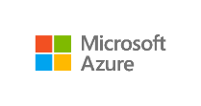

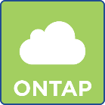
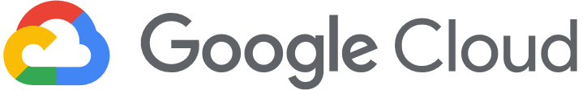
Hybrid Cloud Solution with Cloud Volumes ONTAP
A large telecom group in Europe
A large mortgage company in USA
A genomics and cancer research company in USA
A large healthcare provider in USA
Cloud Volumes
Dev/Test (NetApp®
Cloud Volumes ONTAP®)
Financial and mortgage app
(Cloud Volumes ONTAP)
Research and AI (Cloud Volumes ONTAP)
DR
(Cloud Volumes ONTAP)
IT + core apps (FlexPod®)
IT + core financial apps (FlexPod)
IT + research + AI (FlexPod)
IT + core apps (FlexPod)
Notes:
So, there are other customers who are all using Cloud Volumes ONTAP in addition to flexpod in very different use case settings. So, let's take a quick look at a few of those use cases.
One large telecom company in Europe is using FlexPod to run their mission critical applications and Cloud volumes ONTAP for their dev test functionality.
A mortgage company in the US… they use flexpod to run their it and core financial applications, but the client facing financial and mortgage applications were around using cloud volumes on tap in the public cloud
A research and genomics company in the US they kept their core research, and IT and AI workloads on flexpod, but they kept some of their research and AI functionalities on cloud volume.
A large healthcare provider in the US, they used flexpod to run their IT and core applications and cloud volume was used for disaster recovery. So as you can see there are multiple use cases when it comes to hybrid cloud and all these use cases are enabled by fixed bond.

Slide 15
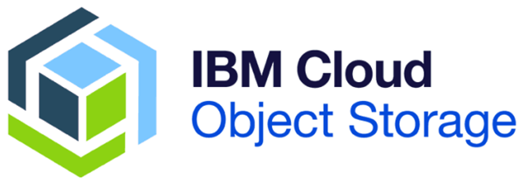
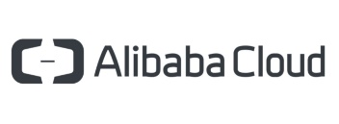
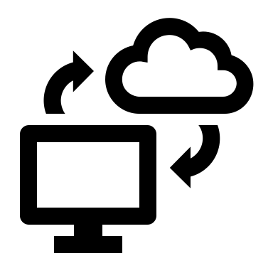
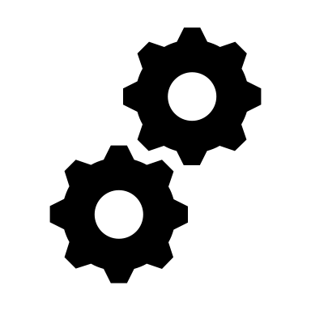

Cloud Tiering with FlexPod
Moving cold data to public cloud
Moving infrequently accessed data to the cloud frees up valuable flash storage space on AFF to deliver more capacity for business-critical workloads to the high-performance flash tier
Hybrid cloud
Simple data management
Smart economics
Extends primary storage to public cloud
Automated cloud tiering transparent to applications
Retrieve cold data from public cloud
Lower TCO using tiering of inactive data to lower-cost storage
Cold data
Hot data
https://www.netapp.com/us/media/tr-4801.pdf
Notes:
So we have a solution that enables you to tier your storage from on prem to the public cloud. In fact, if you track your storage usage, you might find that a lot of data are actually cold that is not frequently accessed. And if that data is sitting on a relatively high performing storage device like SSD, then probably you’re not taking the full advantage of SSD because usually SSD offers high IOPS and low latency and that can accelerate your performance of critical workloads. So, in a way you can move those cold data to lower cost storage device. And in this particular solution, we showcased how you can move your cold data from on prem FlexPod to AWS S3 very easily and you can retrieve that data back whenever you need. So it offers serious smart economics.

Slide 16
FlexPod with Cloud Insights
Modernize your FlexPod storage monitoring, troubleshooting, and optimization capabilities with Cloud Insight and expand to hybrid cloud as needed. This solution focuses on Cloud Insight basic offering with FlexPod®.
Advanced capabilities
Rapid deployment
Cloud Insight
such as optimized cost and performance and integrates NetApp® Active IQ™-based risk assessment and recommendations
ability to be up and running in
20 min. not hours. No customer patching, updates, upgrades needed.
Simpler ease of use
Lower TCO
covers global NetApp storage at scale and fully customizable dashboard and landing pages
with basic, standard, and premium options charged on per-month basis
Notes:
We have another solution with NetApp cloud insight. This showcases that cloud insights which is a cloud-based application works with FlexPod and it is able to monitor, troubleshoot and optimize FlexPod storage. And you can also extend it to hybrid cloud use cases as well. It offers advanced capabilities like active IQ based risk assessment and recommendations. It helps you rapidly deploy. You know the cloud inside capabilities, the monitoring troubleshooting and optimization capabilities are very simple to use and it lowers your TCO.

Slide 17




Build Your Private and Hybrid Multicloud with FlexPod
Innovate faster with agile FlexPod®. Scale FlexPod quickly and easily without disruption and connect to public cloud.
Harness DevOps capabilities and app portability across FlexPod and public-cloud resources to ensure freedom for app developers.
Deploy a high-performance and reliable FlexPod on premises with confidence and connect it to the public cloud.
Ensure security for workloads running on FlexPod by keeping control over data and moving data seamlessly as needed using public-cloud security and resources.
Protect your investment with FlexPod by leveraging Data Fabric and data services FlexPod offers with public clouds, to bring a balance between your capex and opex.
Notes:
So in the last 10-15 minutes, we saw a whole bunch of solutions we've validated over the time. These solutions, in a way, give you the confidence to move faster, to innovate faster. To connect to the public cloud, you really don't need to go through any disruption, FlexPod has all the hooks and capabilities to work with any major public clouds. FlexPod also gives your DevOps engineers the freedom to build your applications because once you build these applications, you're able to move them wherever you need. You're also able to move the data across locations. FlexPod is inherently a high performing and reliable platform so it not only gives you ability to run your mission critical applications with enough confidence, but also enables you with hybrid multi cloud architecture. You are able to leverage public cloud resources and you can determine what is the right location for your workload. No matter what the architecture looks like, you know, whether it is hybrid multi cloud or private cloud or traditional implementation, security is one of the key pillars and we definitely make sure security is inherently addressed in every single component layer, be it compute networking storage or hypervisor. And finally with FlexPod, you are now able to protect your investment because it not only allows you to run your applications today, but also gives you a way to extend to your future need.

Slide 18
FlexPod® delivers private cloud use cases
FlexPod enables hybrid multicloud use cases
FlexPod-based hybrid clouds work with all the major public cloud providers
Notes:
So, the key takeaways… FlexPod helps you address the private cloud use cases. And we have a number of solutions for that. It also gives the ability to build hybrid multi cloud and address those hybrid cloud use cases. Also FlexPod based hybrid cloud, as we spoke earlier, works with the major public cloud providers.

Slide 19
FlexPod Sessions and Resources
Speed Breakout Session (20 minutes)
SPD-1147-2 | Learn Why FlexPod Has the Best Integration with Cisco Intersight​
SPD-1144​-1 | FlexPod Infrastructure Innovation and End-to-End NVMe ​
SPD-1470-1 | FlexPod Solutions for Private and Hybrid Multicloud Use Cases​
SPD-1152​-1 | Learn Why FlexPod is Perfect for Private, Hybrid and Multicloud​
SPD-1149-1 | Enable Healthcare Digital Transformation with FlexPod​
SPD-1150​-2 | Digital Transformation with SAP HANA and DATAHUB on FlexPod​
SPD-1154​-2 | Why Is It Vital to Move to SQL Server 2019 on FlexPod?​
SPD-1471​-2 | Migrate to Oracle RAC 19c on FlexPod, While You Still Have Time! ​
SPD-1153​-2 | Work or Learn from Anywhere with FlexPod VDI​
SPD-1446-2​ | Accelerate Your AI Journey for the Data Driven Enterprise with FlexPod AI
Customer Presented Sessions
BRK​-1062​​-2 | Support Real Time Mission Critical Oracle Workloads with FlexPod | Lawrence Livermore Labs​
BRK​-1528​-1 | How Cannon Design Drove Collaboration & Innovation Globally​ | Cannon Design​
FlexPod Resources
www.flexpod.com
www.netapp.com/flexpod
www.cisco.com/go/flexpod
For FlexPod Channel Partners: www.cisconetapp.com
Blogs: https://blog.netapp.com/tag/flexpod/
FlexPod CVDs
For more information contact us using the form at https://flexpod.com/contact/ OR call us:
Americas: +1 877 263 8277
EMEA: +351 21 454 1004
APAC: +1 800 448 1627
Short Presentation or Demonstration (10 minutes)
DEM​-1478​-1 | Protect Your IT Assets Against Ransomware Using FlexPod
DEM​-1479​-1 | FlexPod for Medical Imaging in 10 Minutes
DEM​-1481​-1 | FlexPod for OpenShift in 10 Minutes
DEM​-1504​-1 | Improve FlexPod Management with Cisco Intersight (10 Minute Demo)
DEM​-1532​-2 | See Microsoft SQL Server Running on FlexPod Demonstration
DEM​-1542​-1 | Learn About the New and Innovative FlexPod Consumption Model

